Slide 2
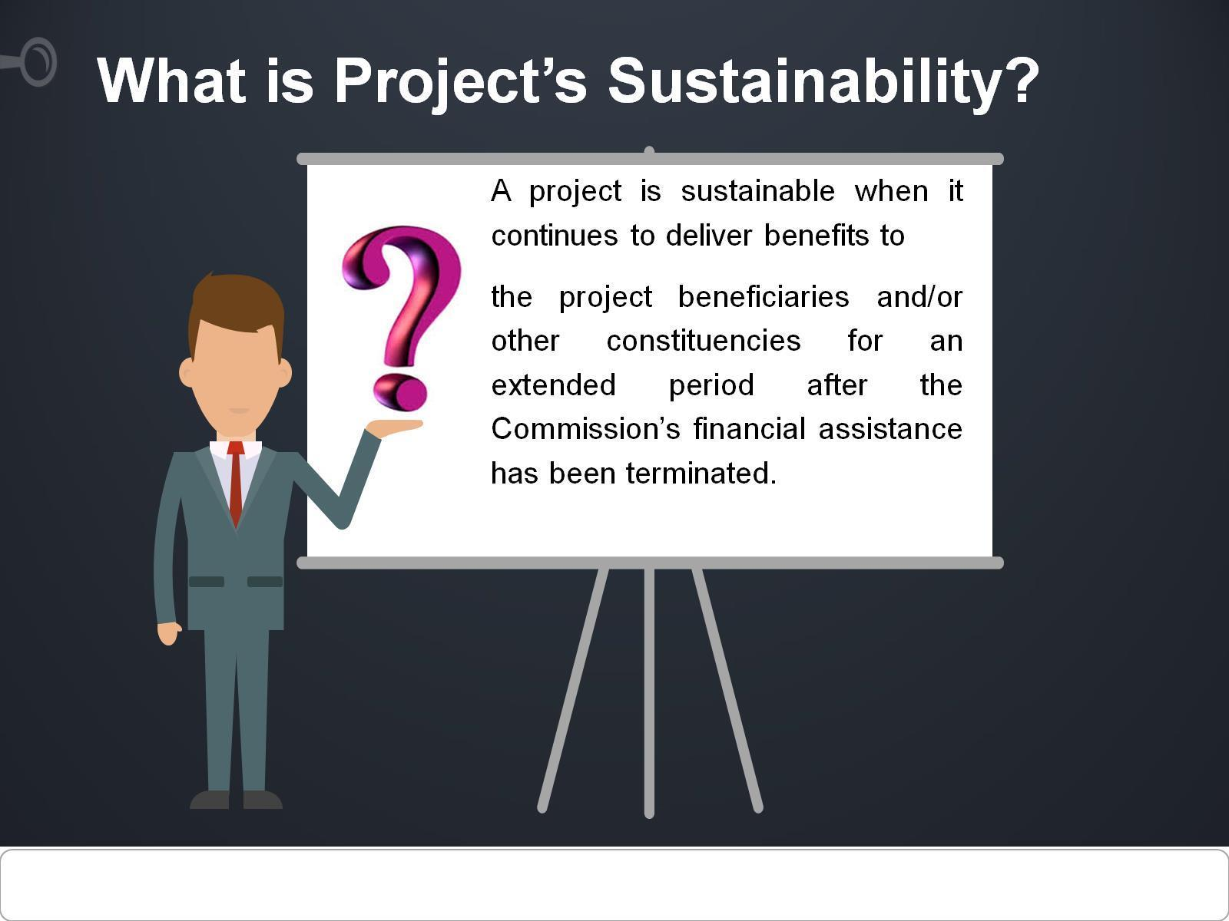
What is Project’s Sustainability?

Slide 3
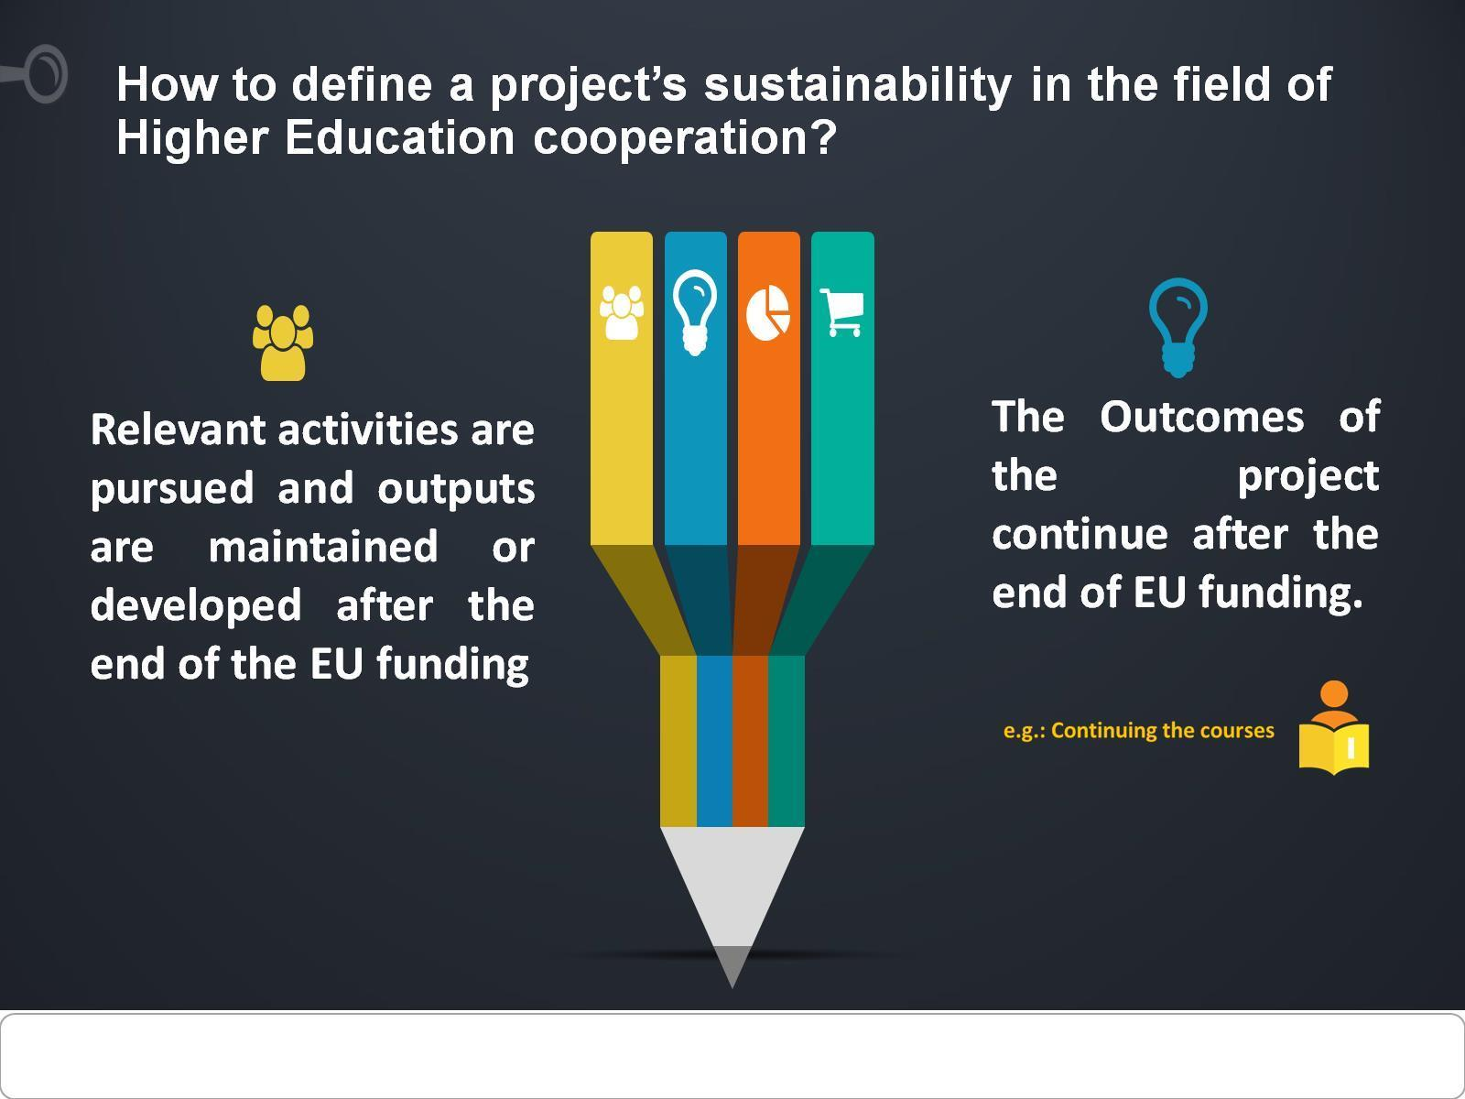
How to define a project’s sustainability in the field of Higher Education cooperation?

Slide 4
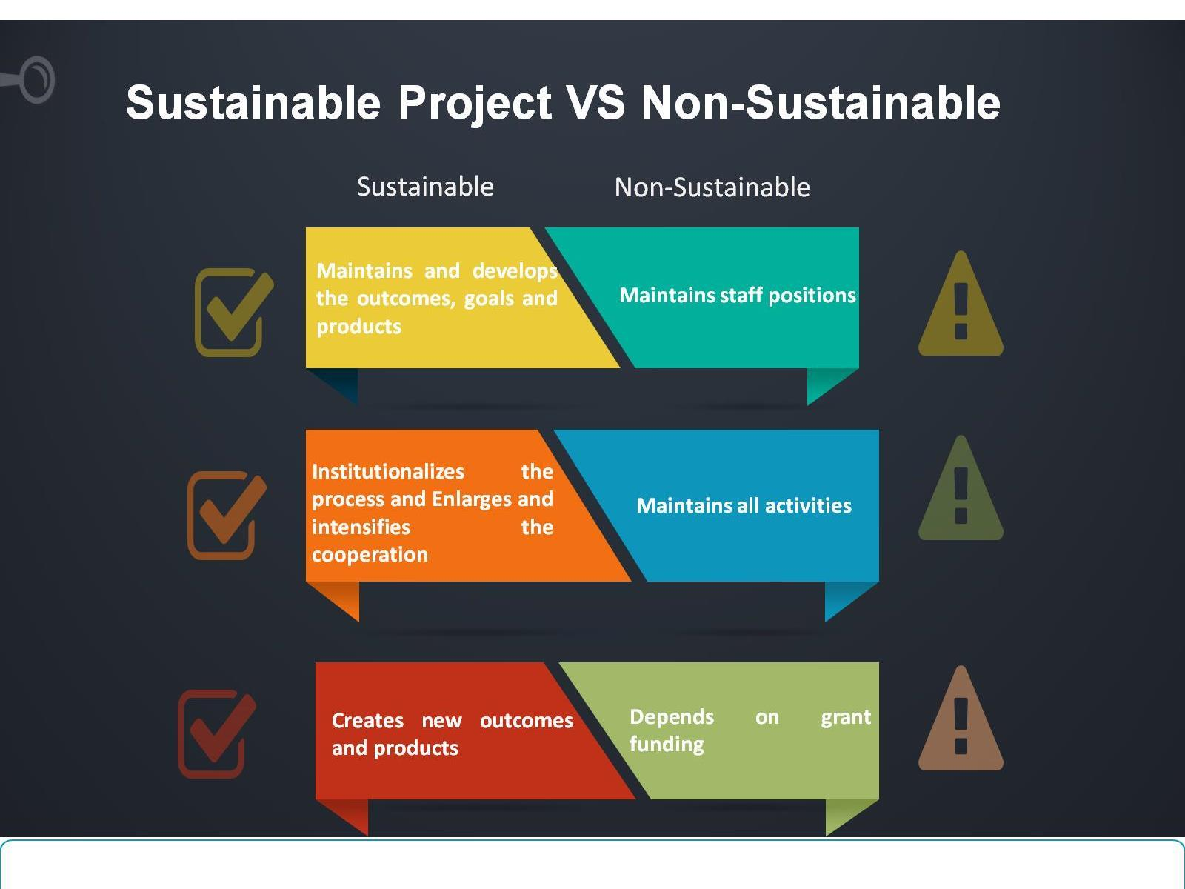
Sustainable Project VS Non-Sustainable

Slide 5
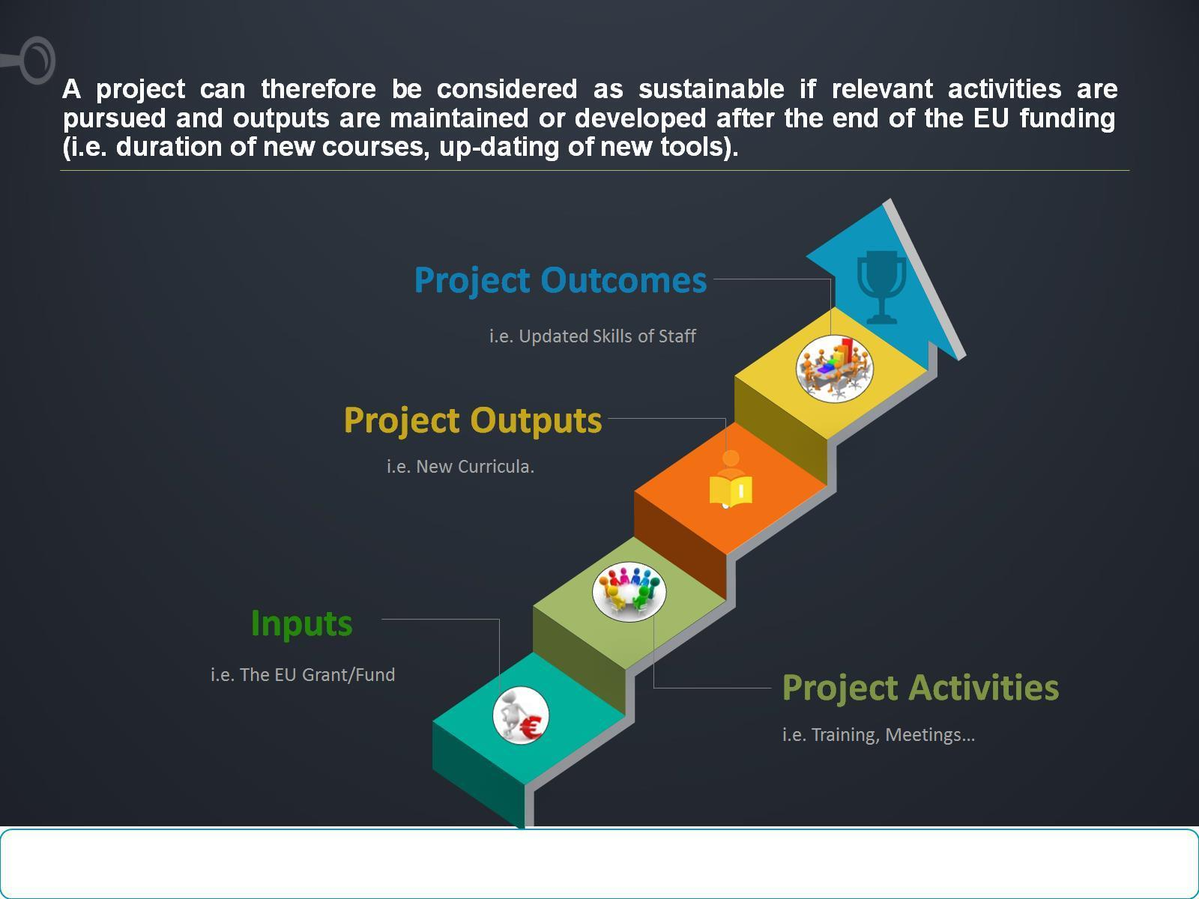
A project can therefore be considered as sustainable if relevant activities are pursued and outputs are maintained or developed after the end of the EU funding (i.e. duration of new courses, up-dating of new tools).

Slide 6
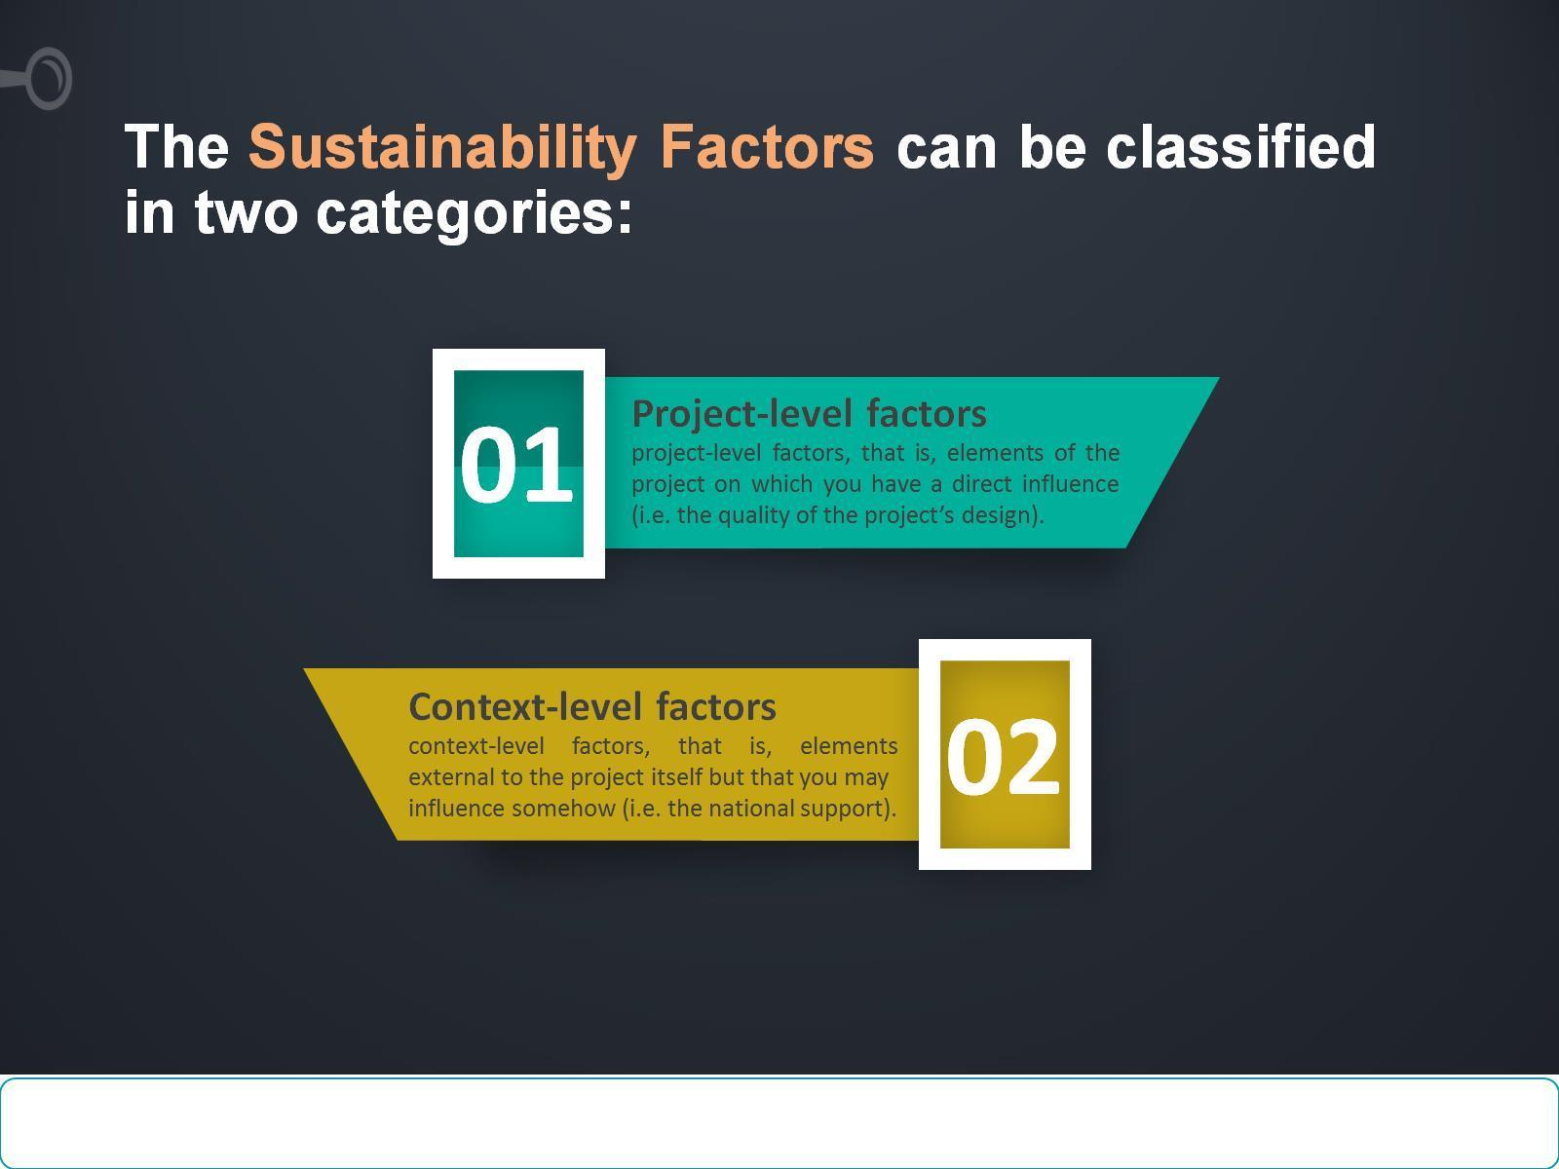
The Sustainability Factors can be classified in two categories:

Slide 7
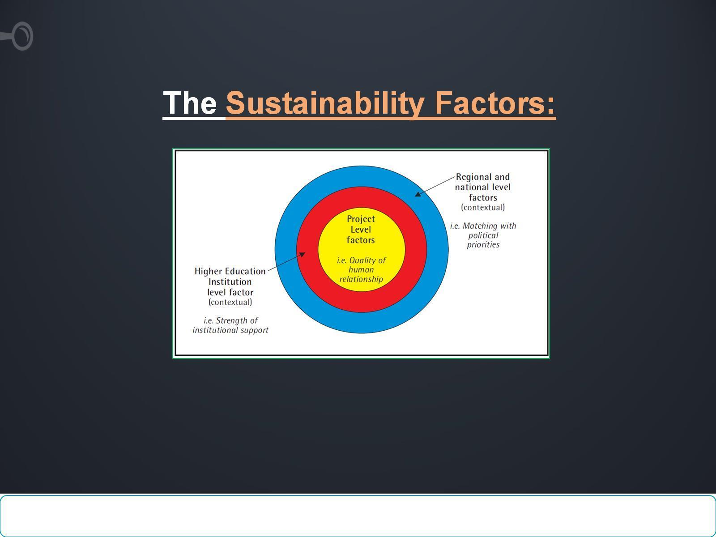
The Sustainability Factors:

Slide 8
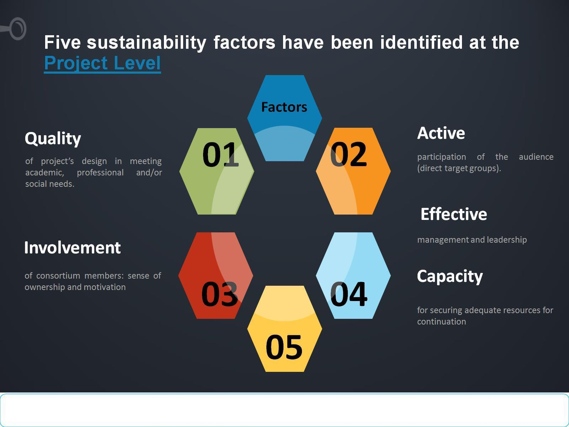
Five sustainability factors have been identified at the Project Level

Slide 9
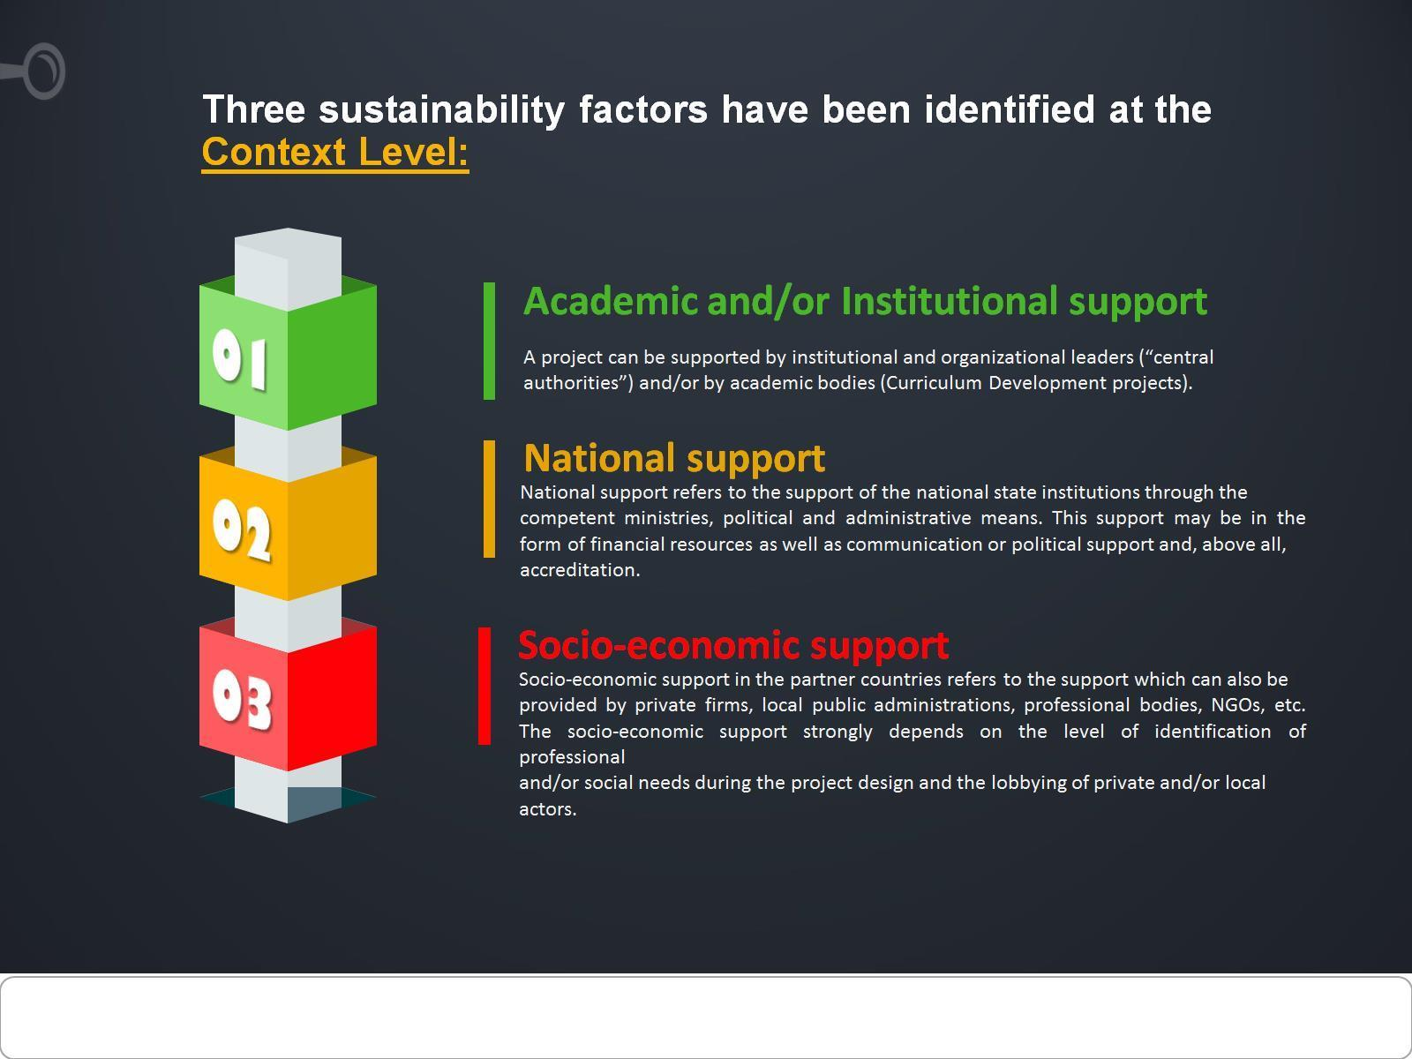
Three sustainability factors have been identified at the Context Level:

Slide 10
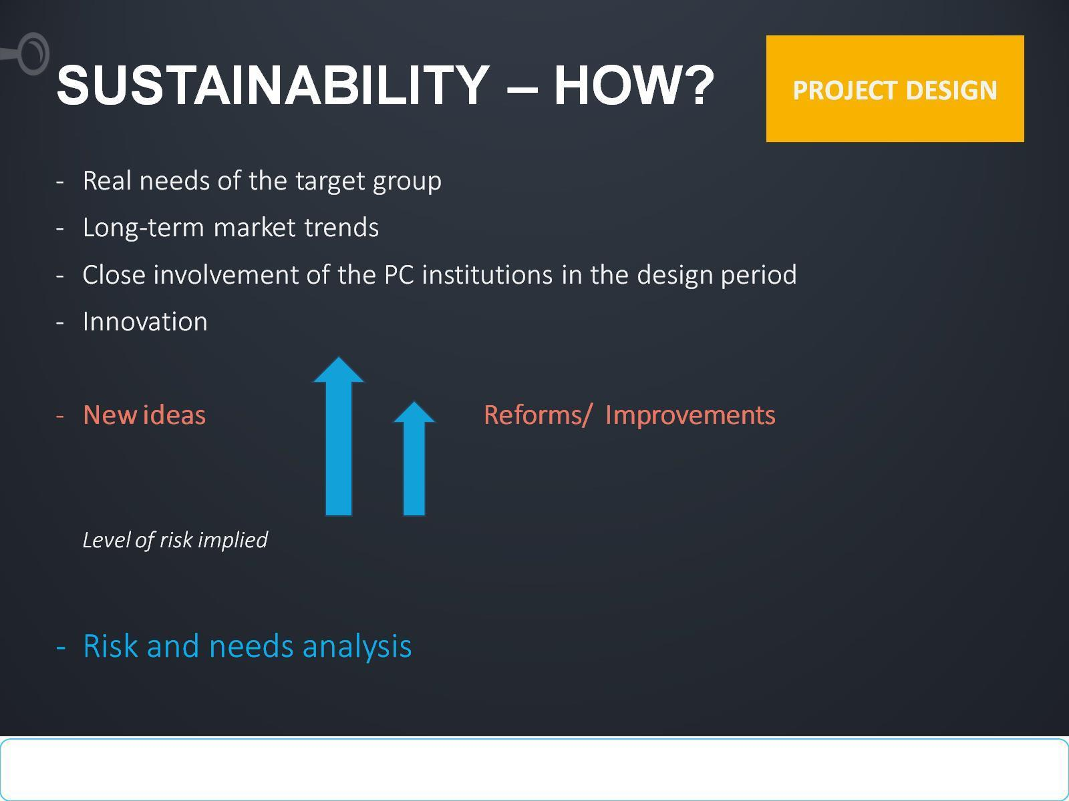
SUSTAINABILITY – HOW?

Slide 11
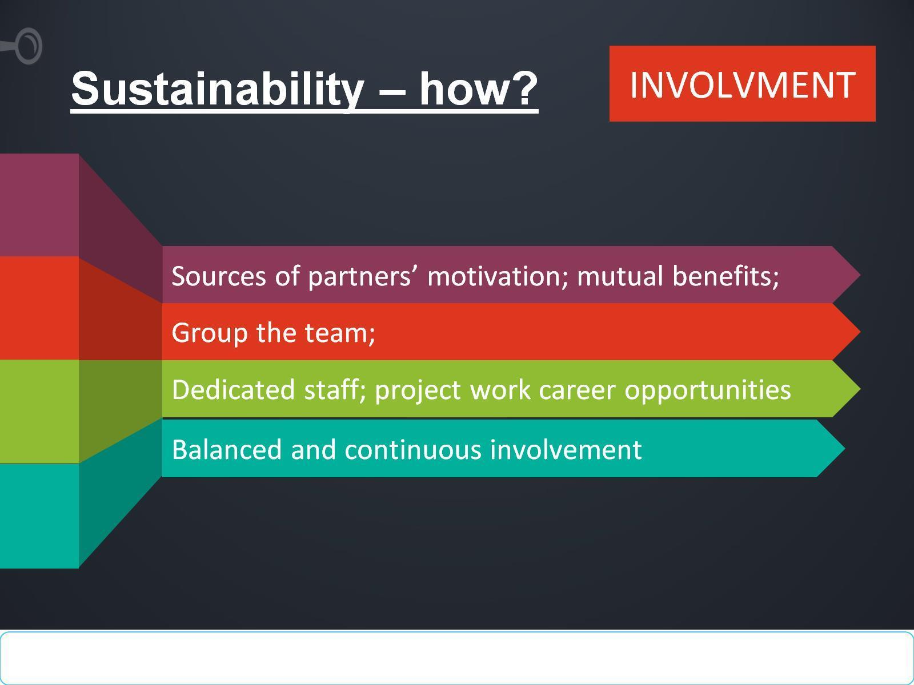
Sustainability – how?

Slide 12
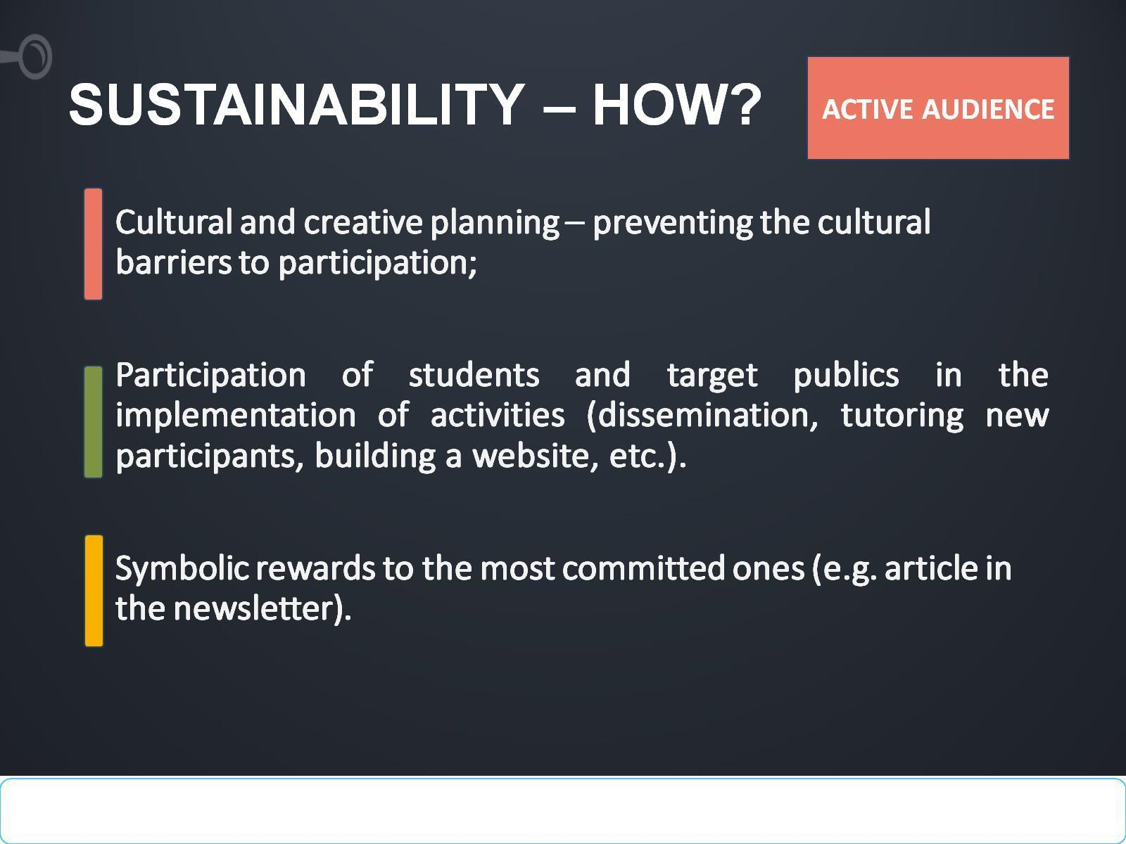
SUSTAINABILITY – HOW?

Slide 13
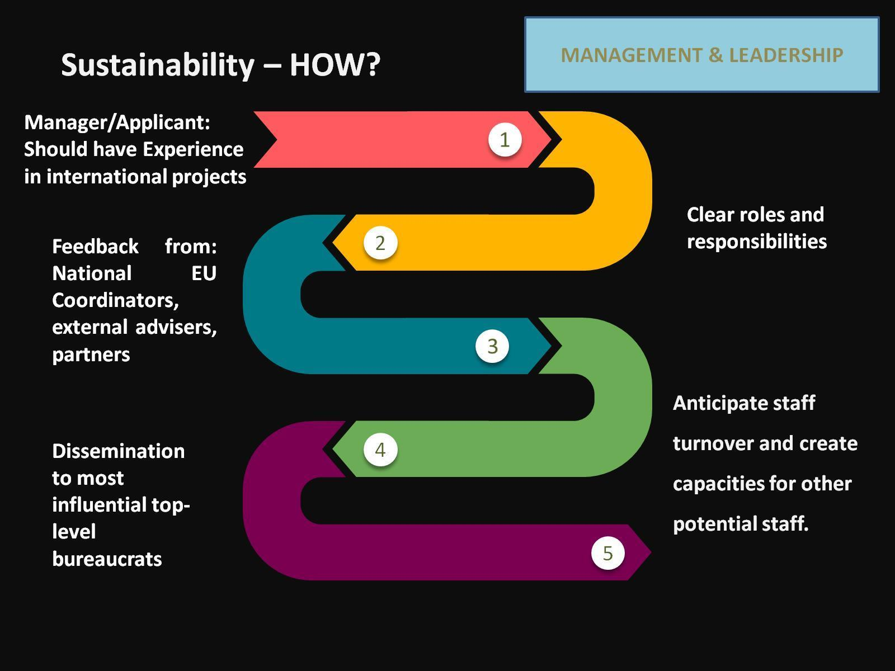

Slide 14
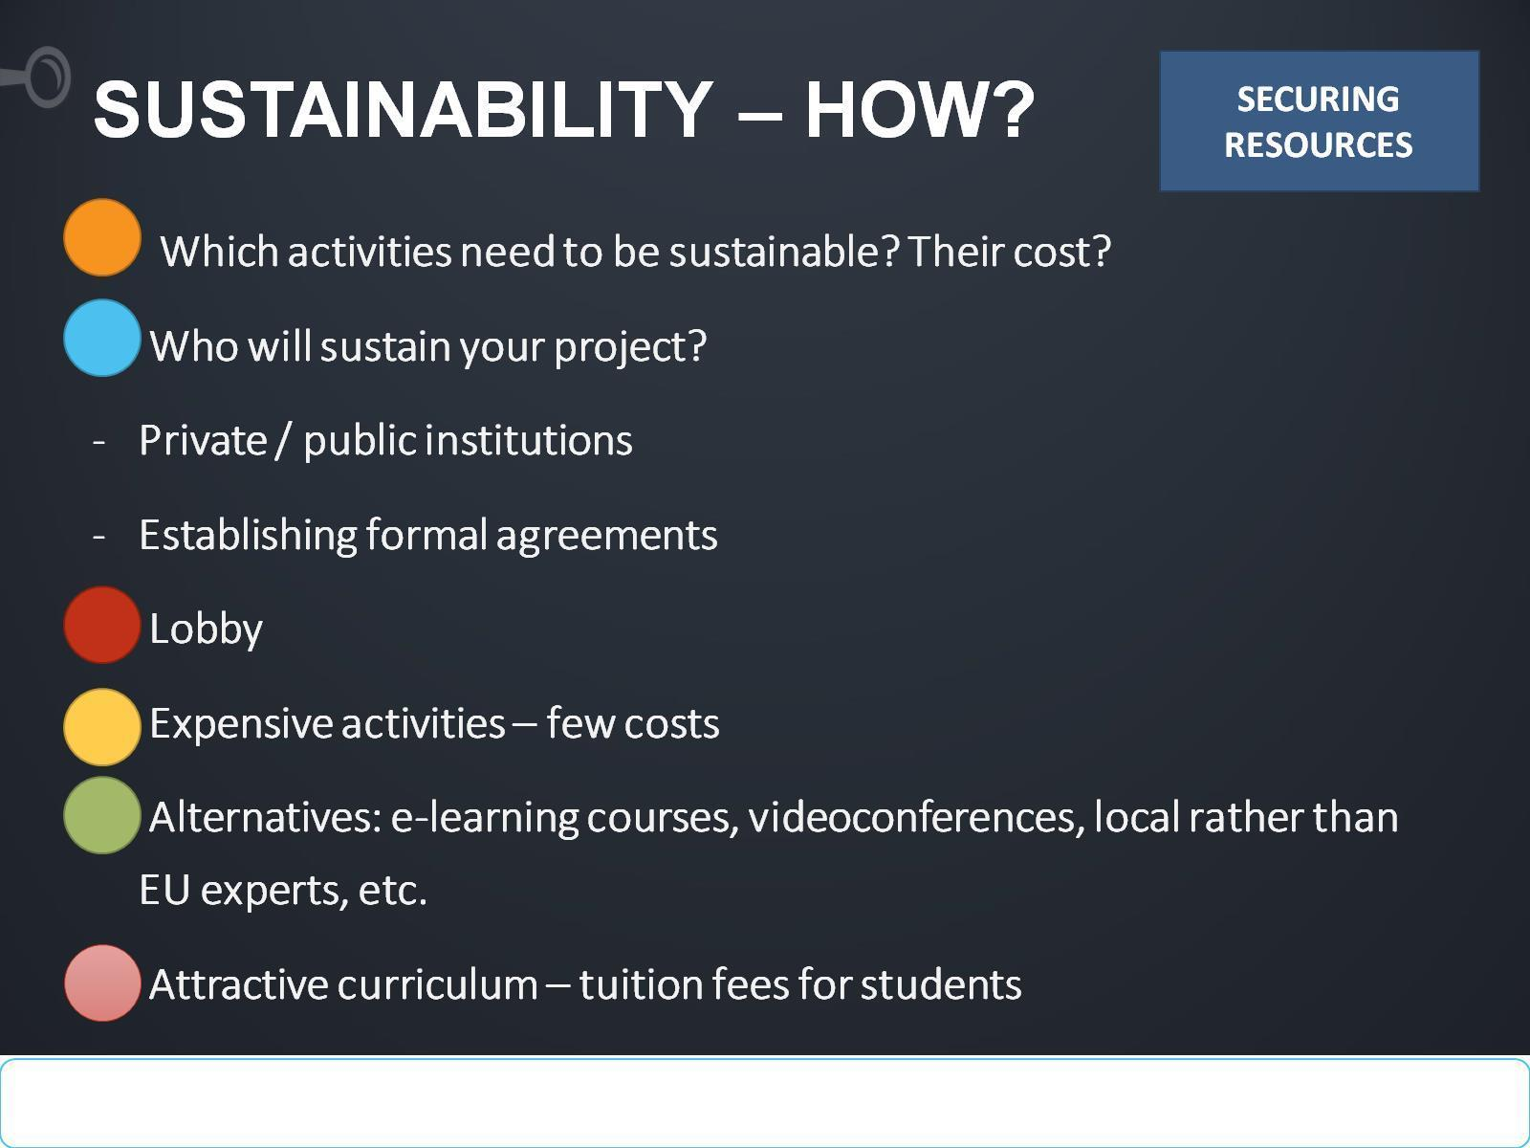
SUSTAINABILITY – HOW?

Slide 15
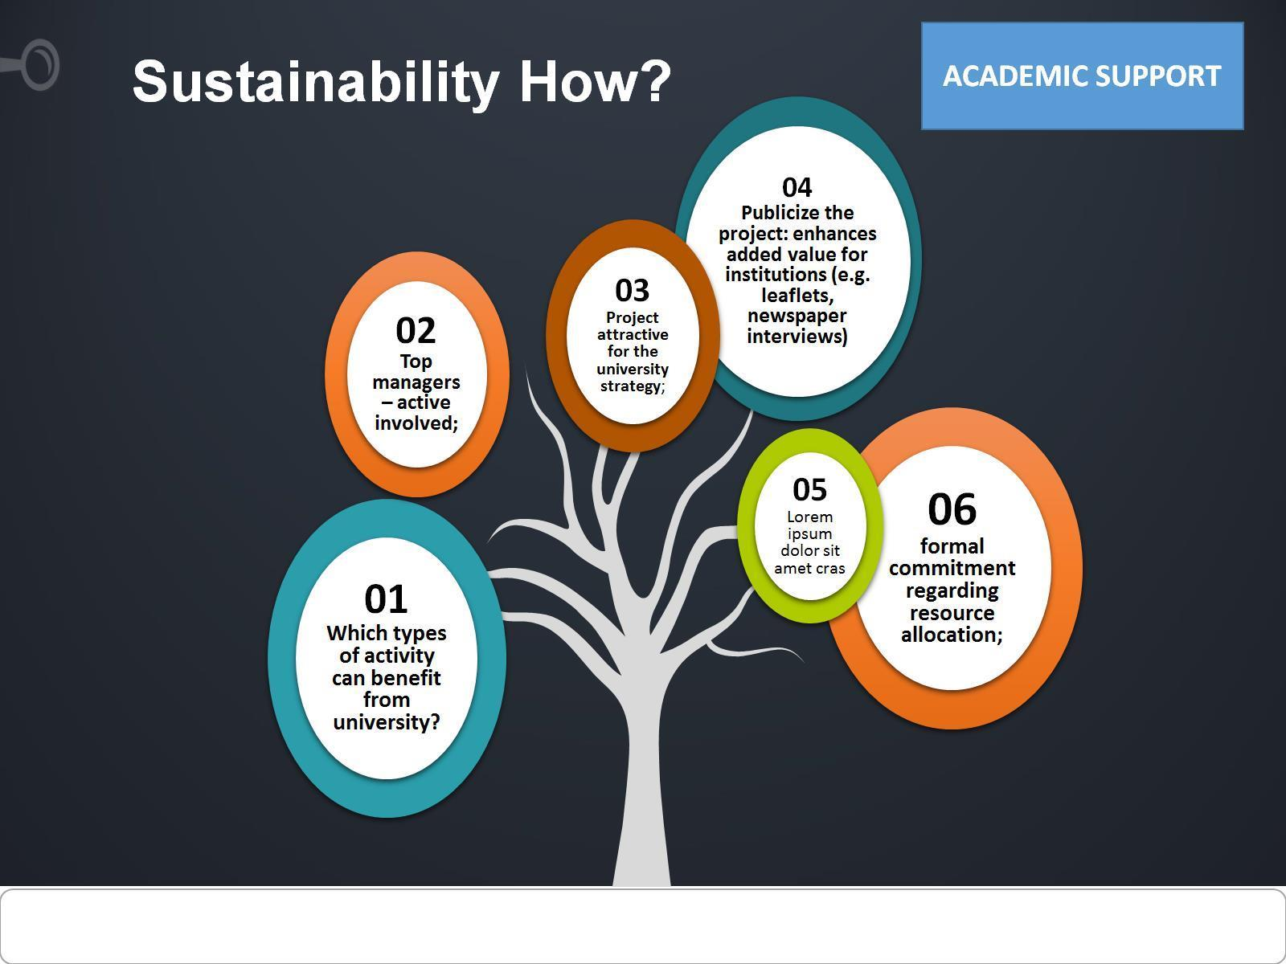
Sustainability How?

Slide 16
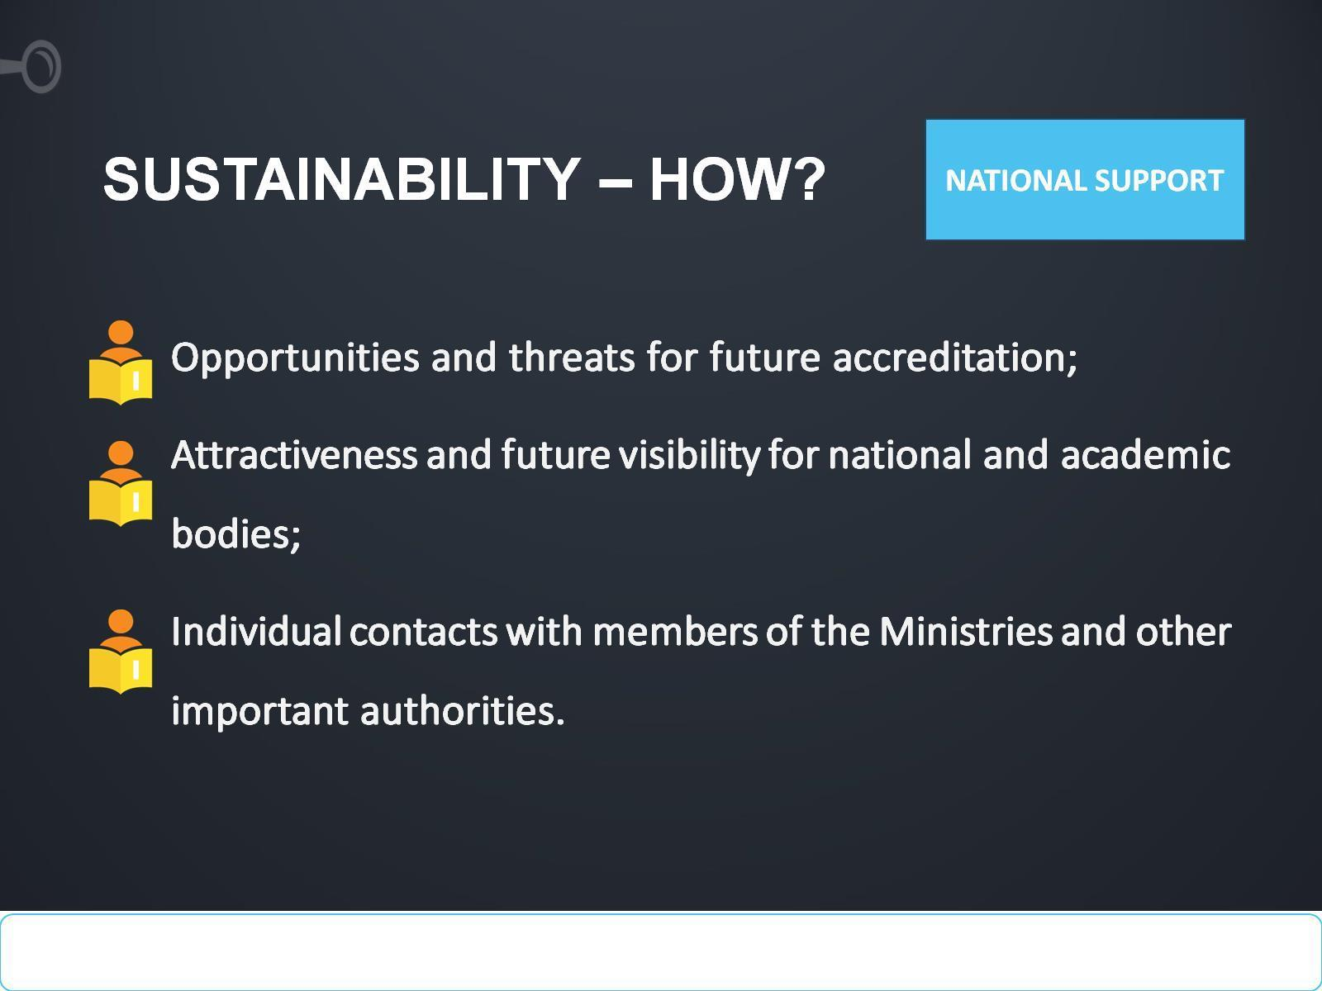
SUSTAINABILITY – HOW?

Slide 17
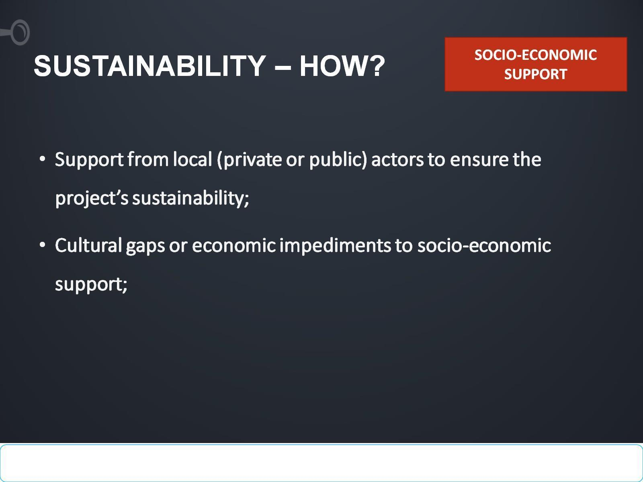
SUSTAINABILITY – HOW?

Slide 18

How FoodQA partners can ensure sustainability of the project ?

Slide 19
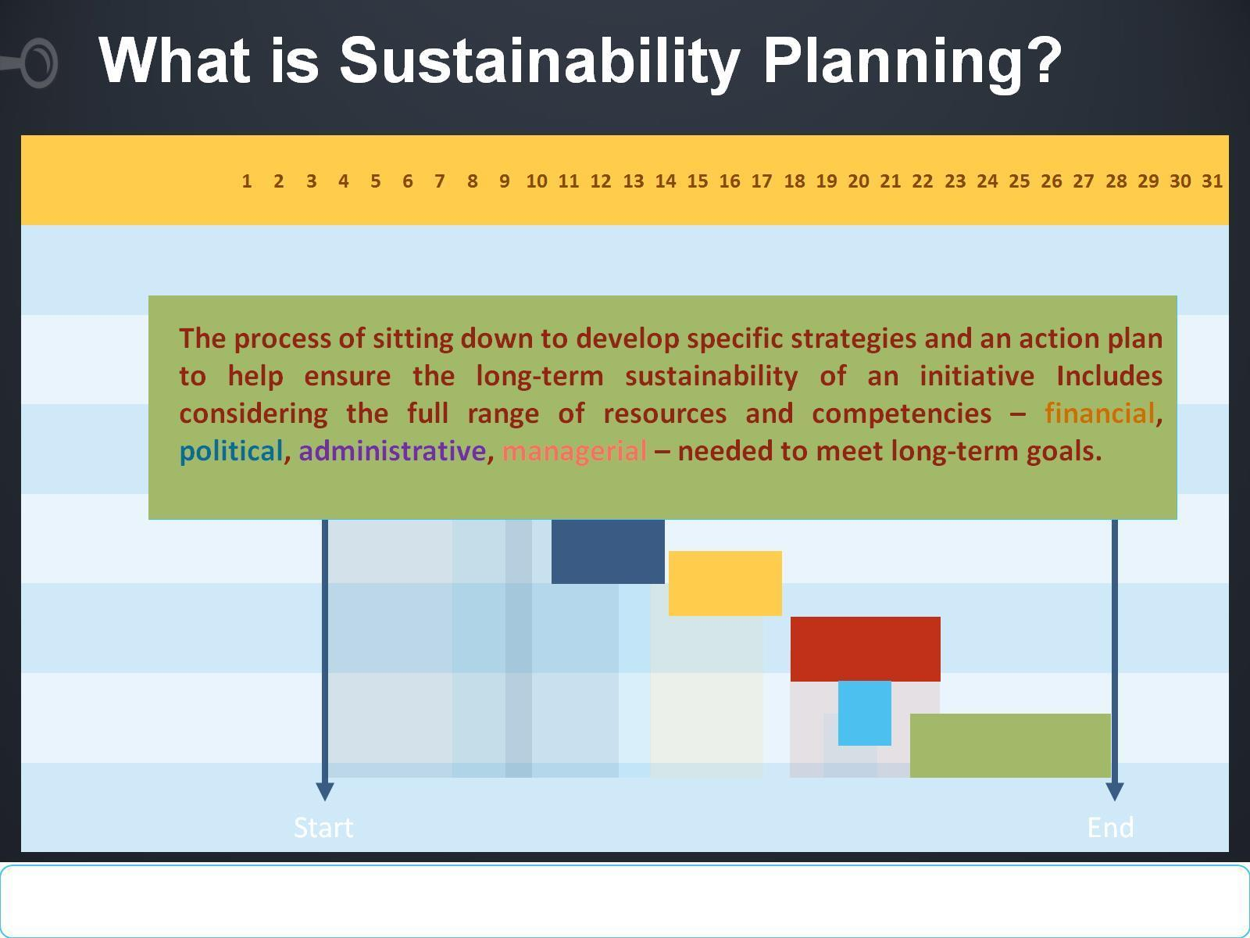
What is Sustainability Planning?

Slide 20
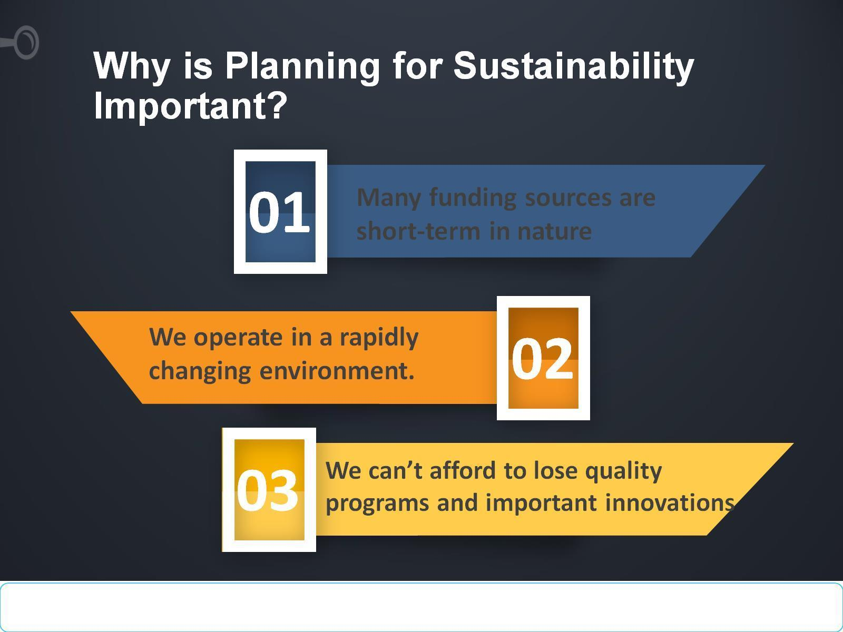
Why is Planning for Sustainability Important?

Slide 21
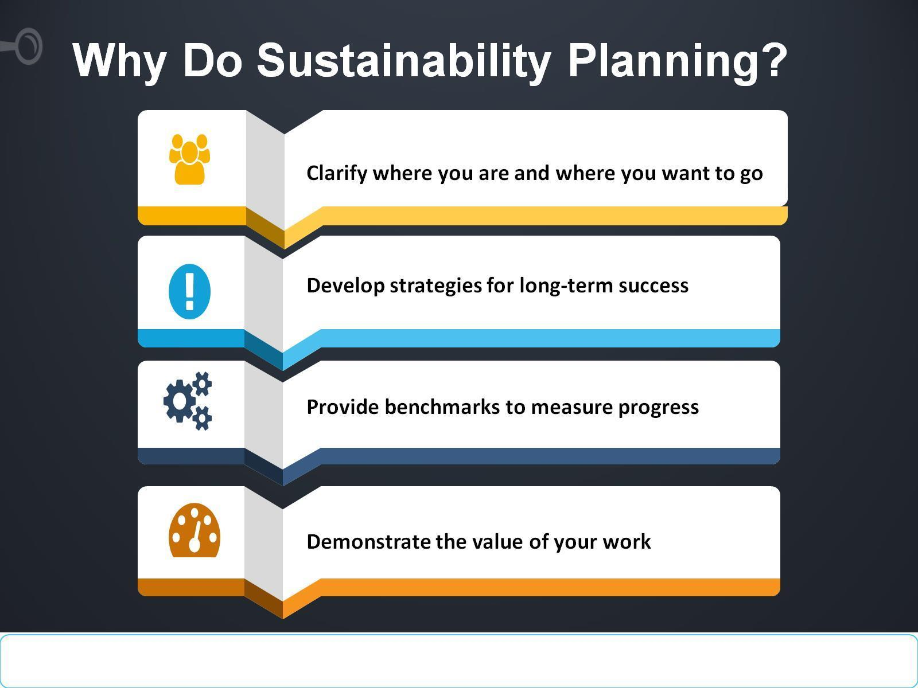
Why Do Sustainability Planning?

Slide 22
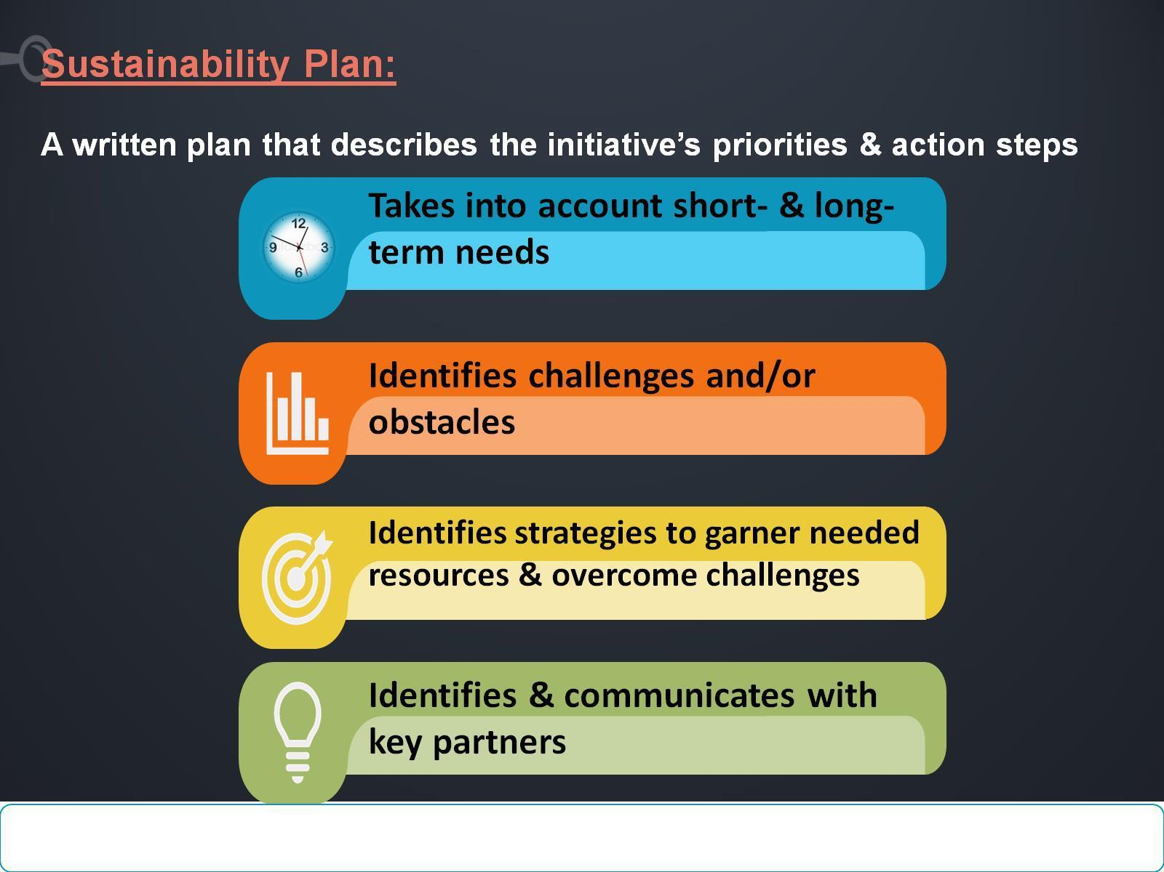
Sustainability Plan:
A written plan that describes the initiative’s priorities & action steps

Slide 23
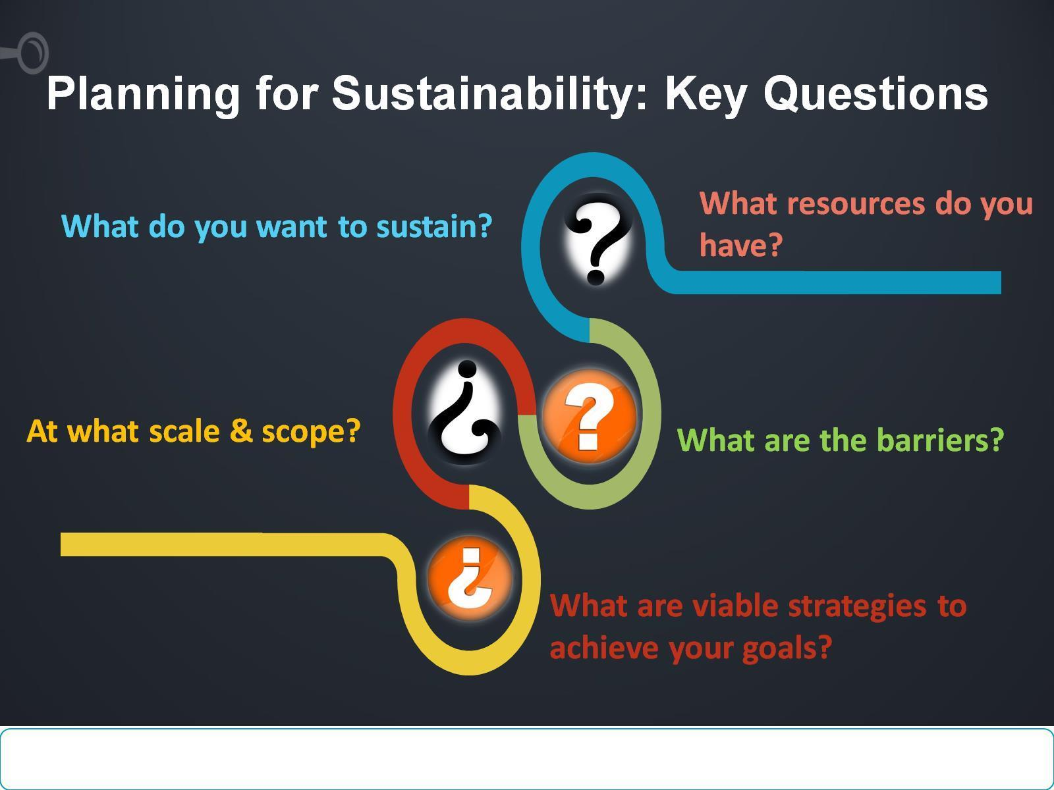
Planning for Sustainability: Key Questions

Slide 24
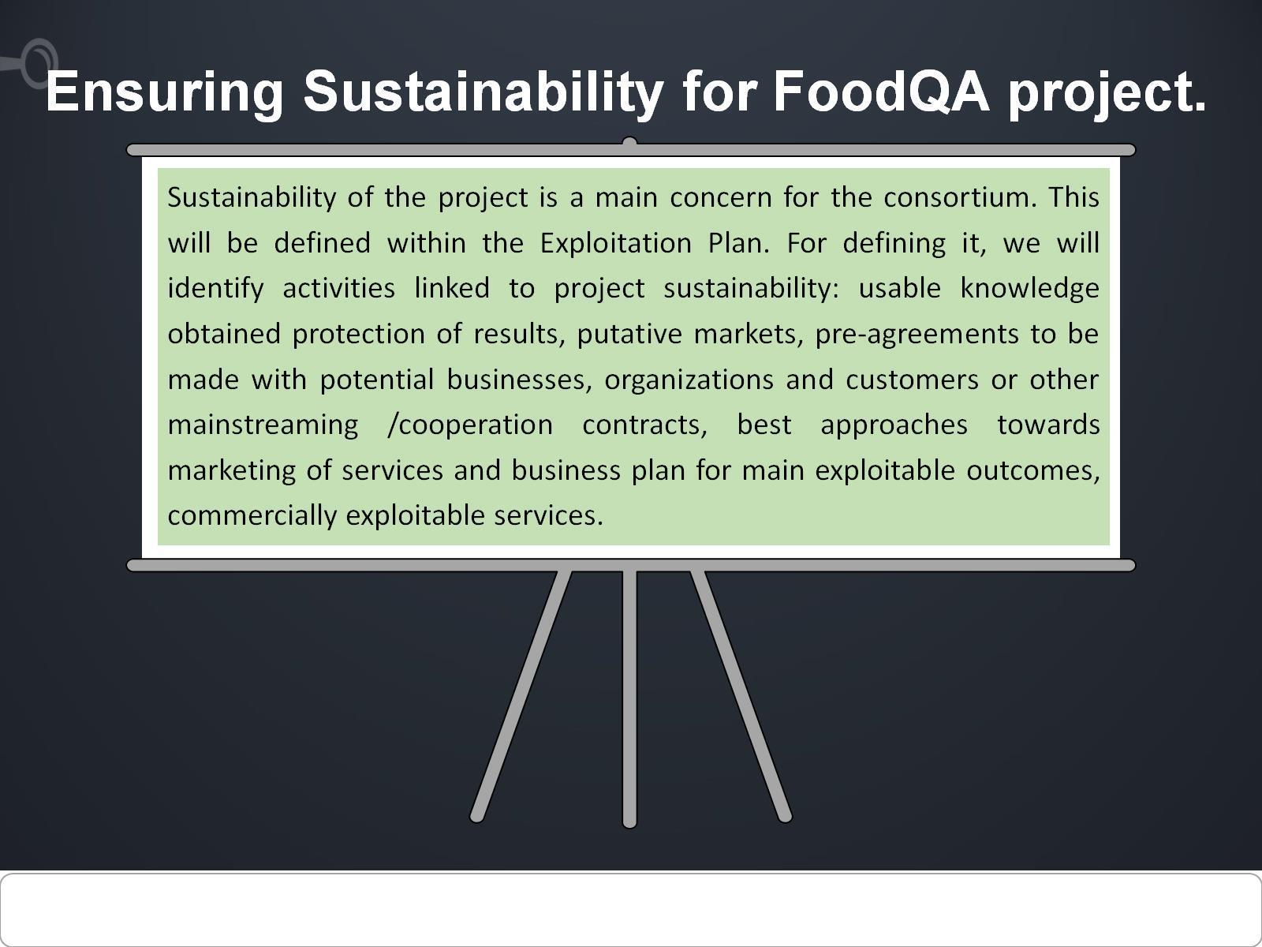
Ensuring Sustainability for FoodQA project.

Slide 25
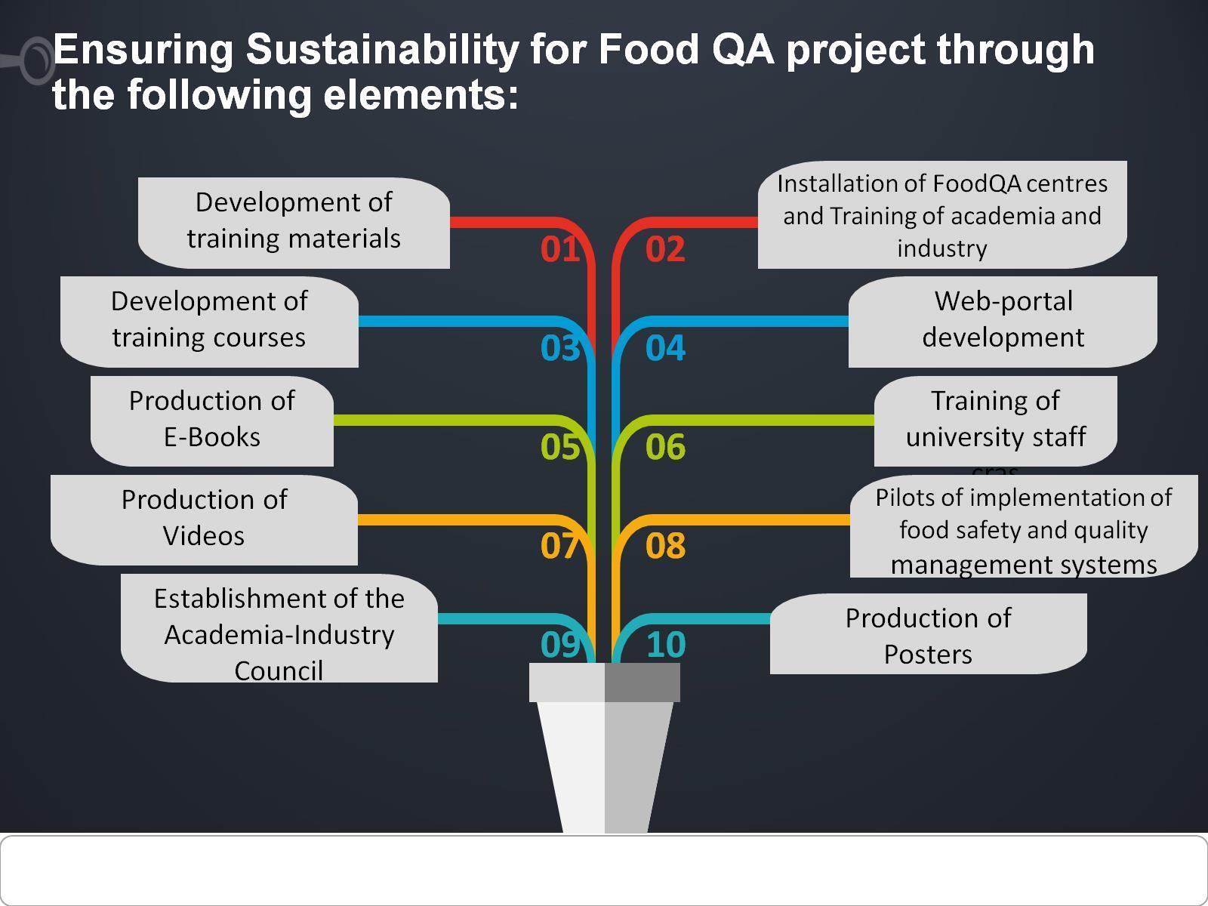
Ensuring Sustainability for Food QA project through the following elements:

Slide 26
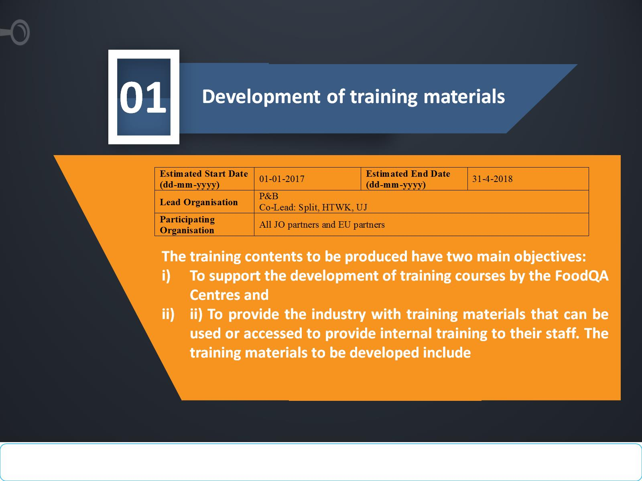

Slide 27
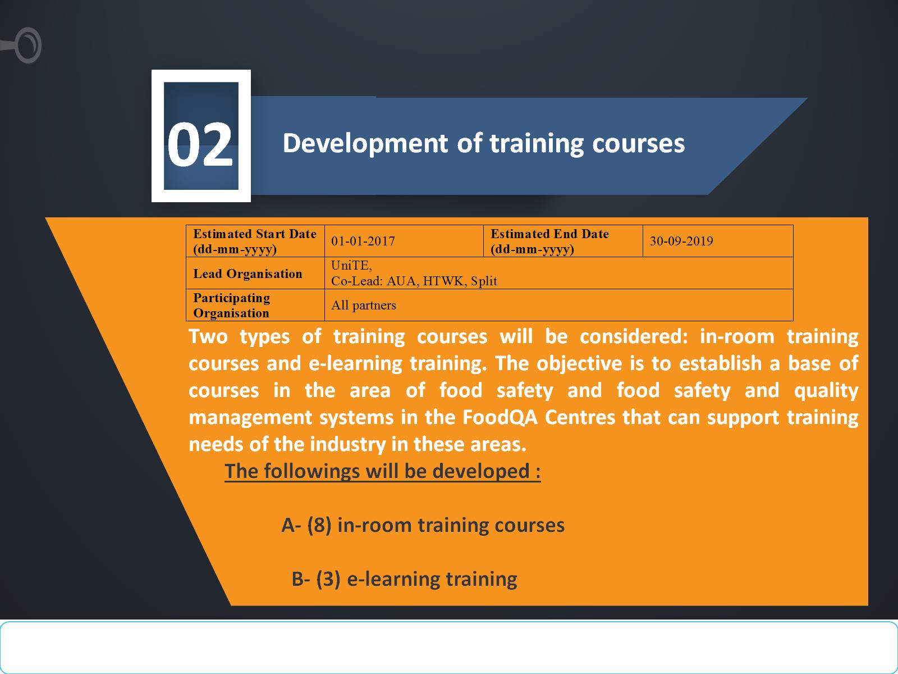

Slide 28
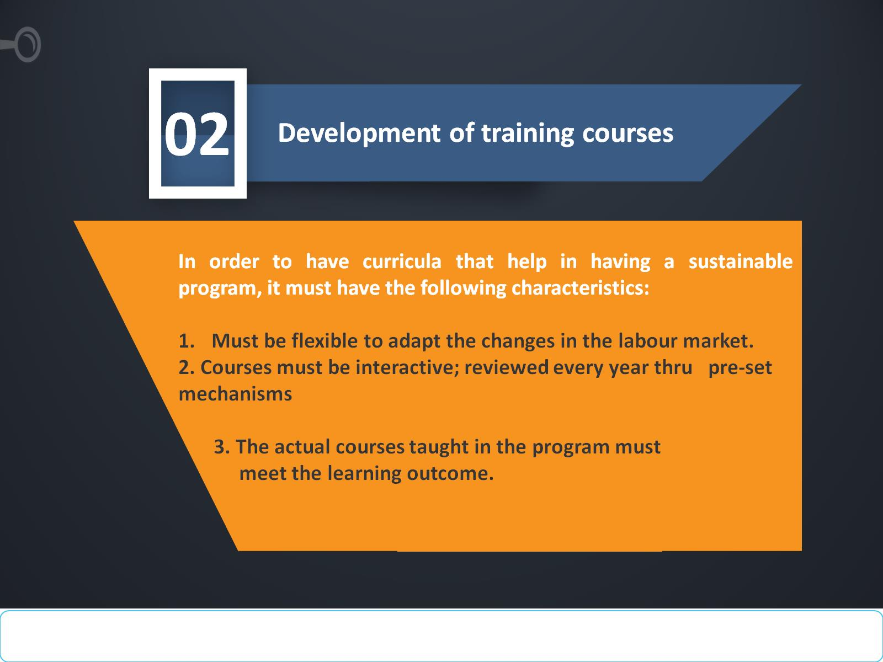

Slide 29
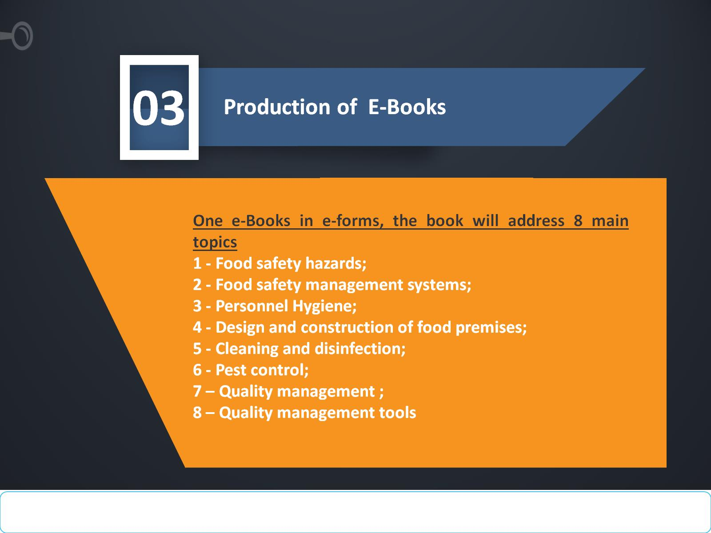

Slide 30
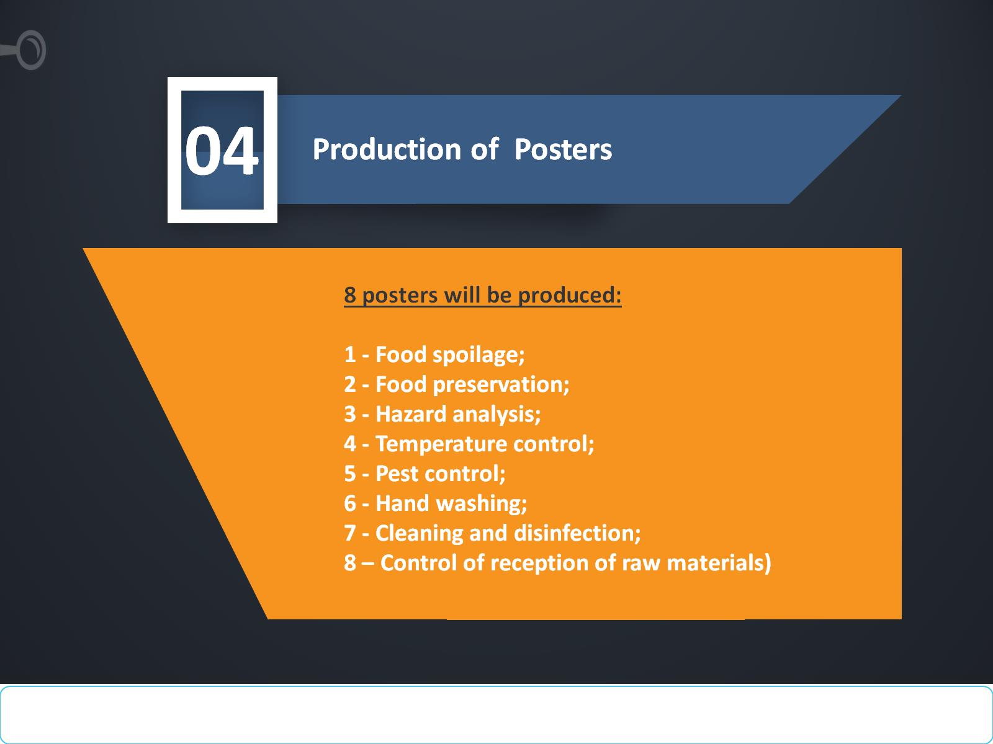

Slide 31
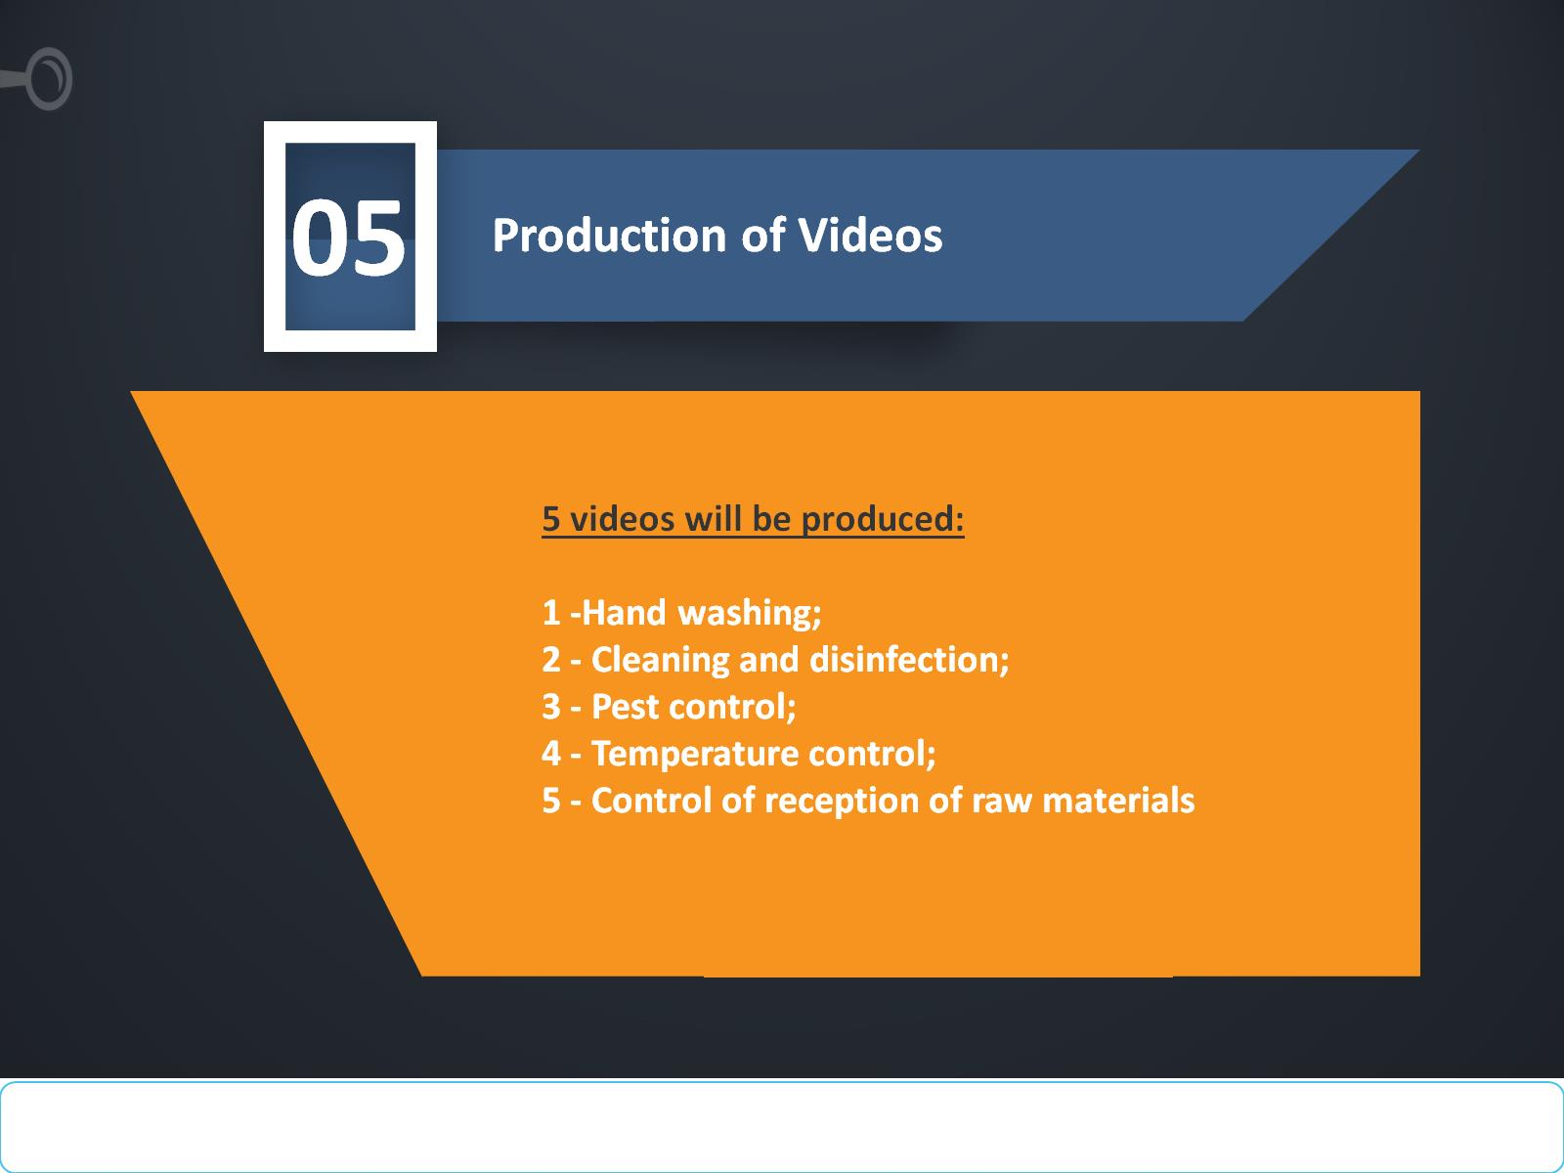

Slide 32
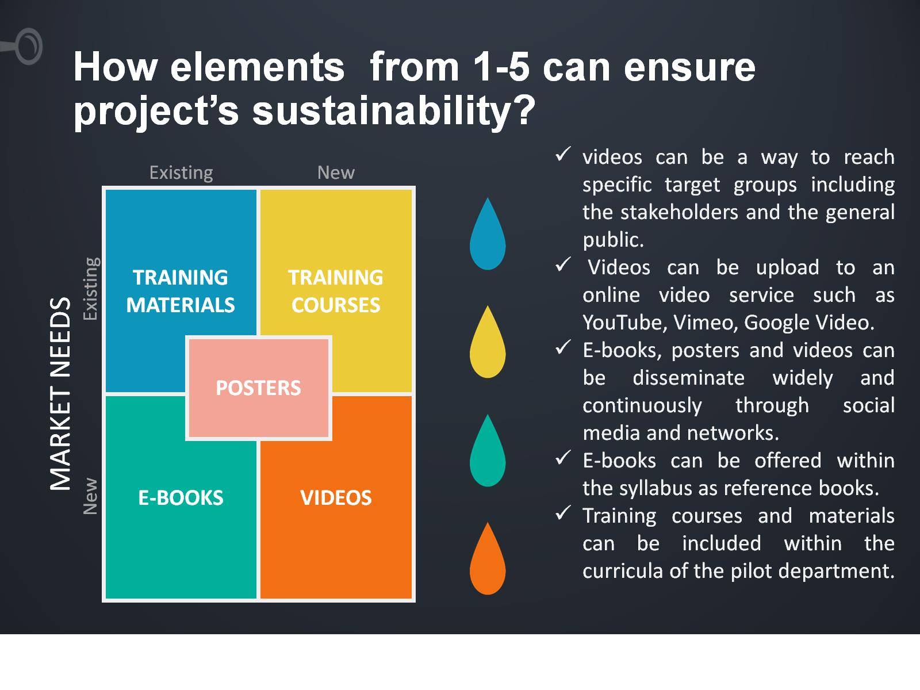
How elements from 1-5 can ensure project’s sustainability?

Slide 33
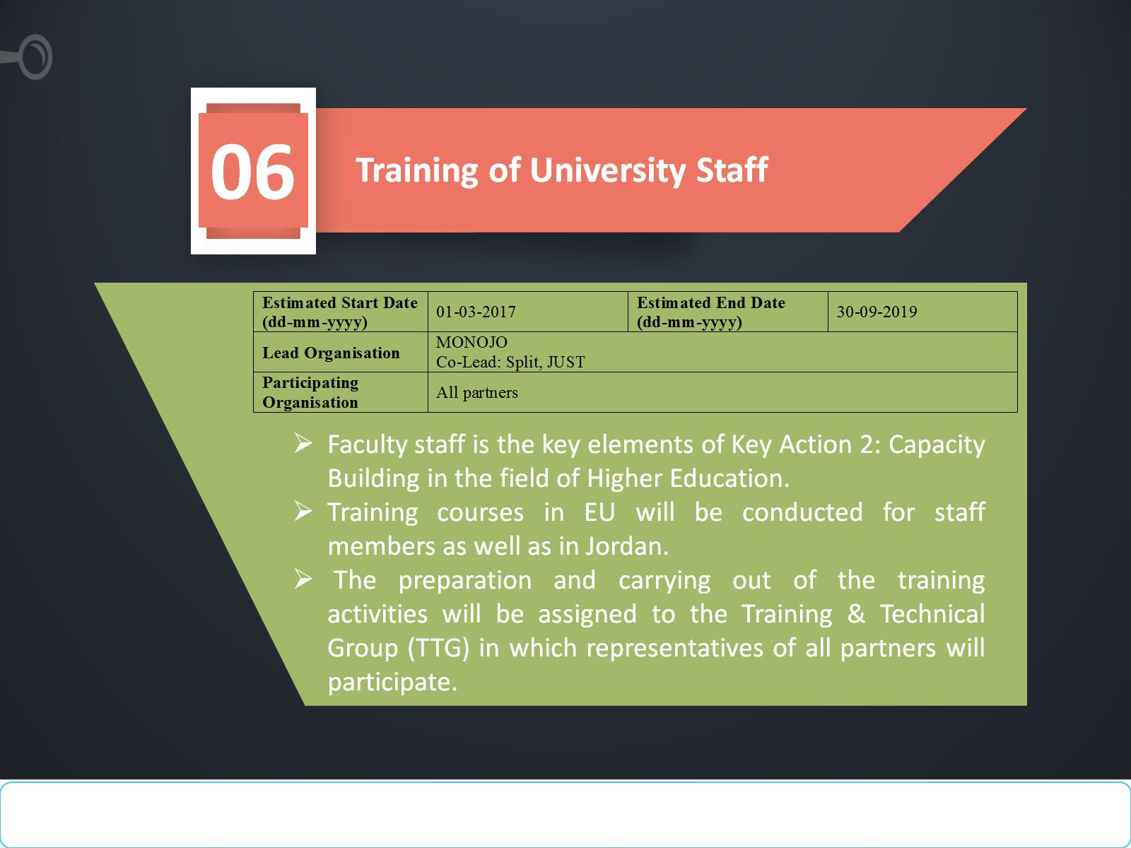

Slide 34
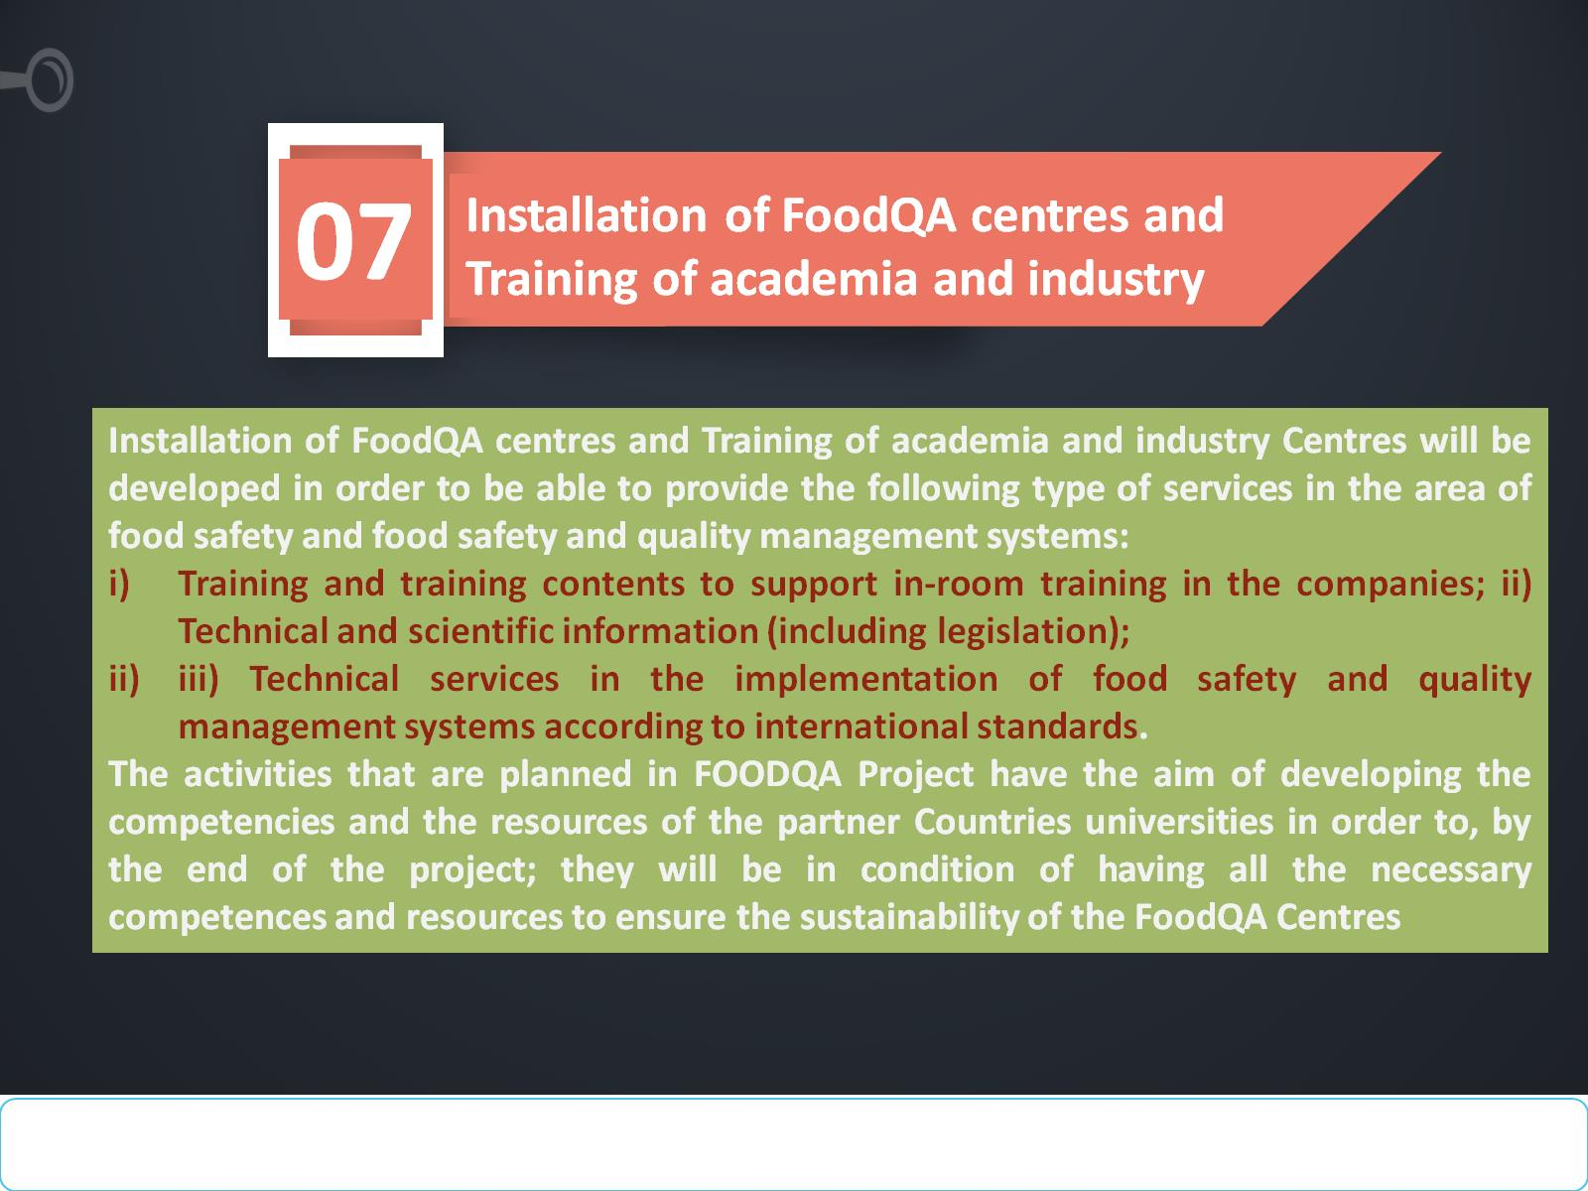

Slide 35
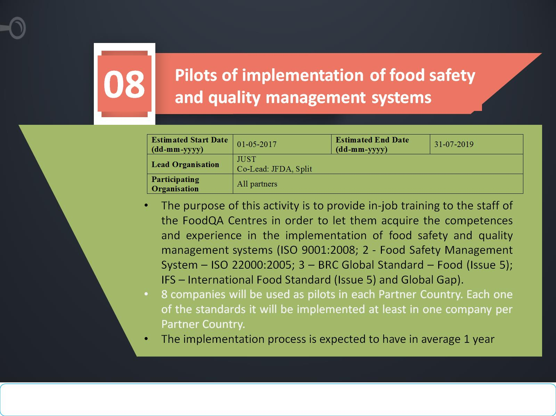

Slide 36
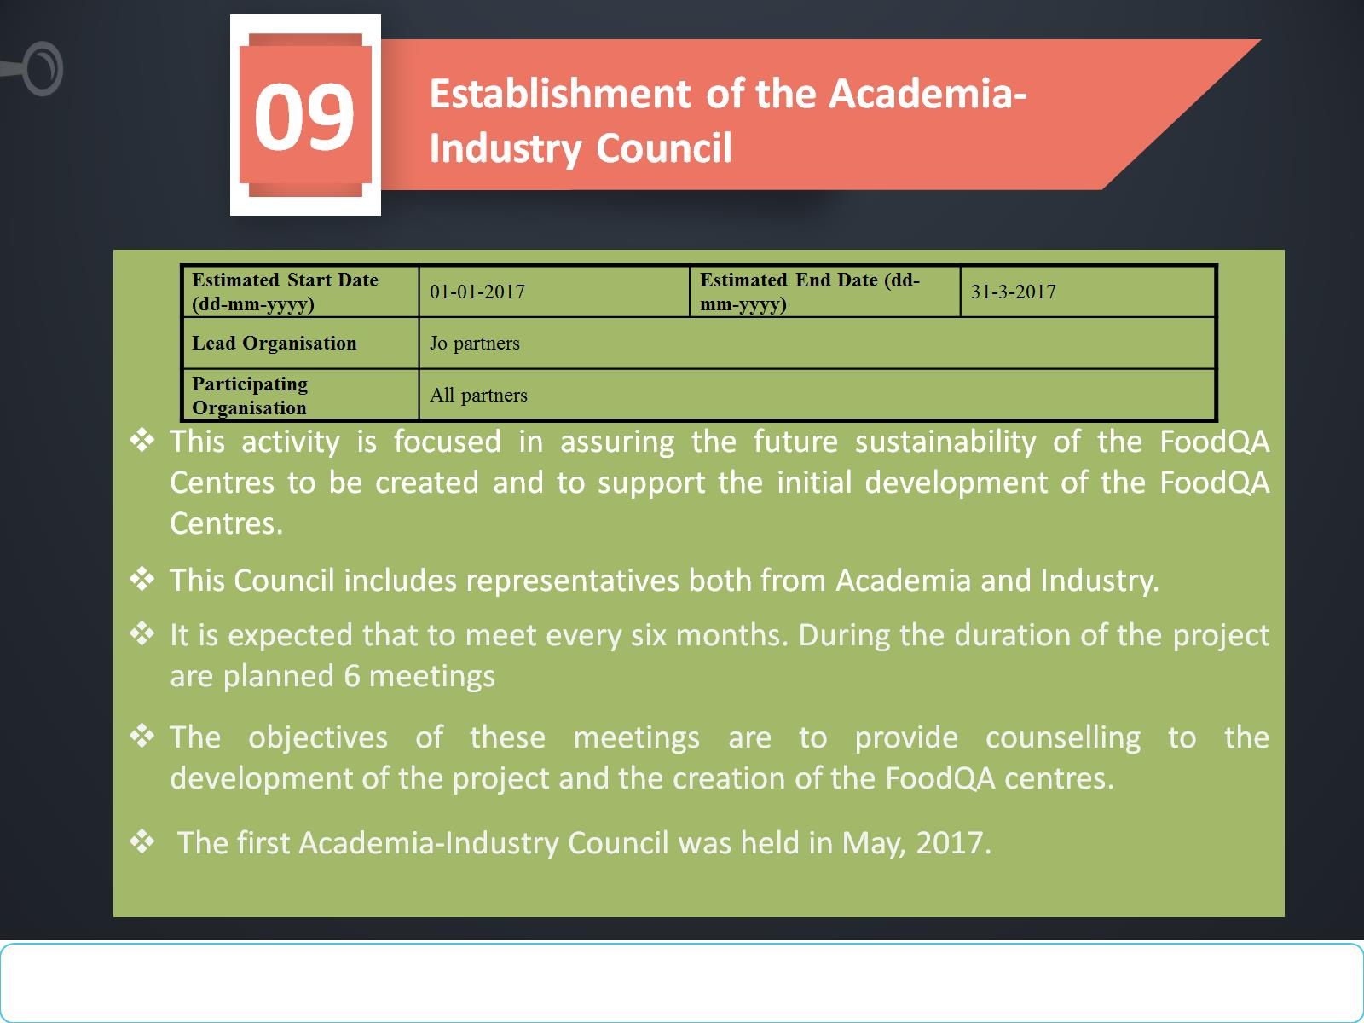

Slide 37
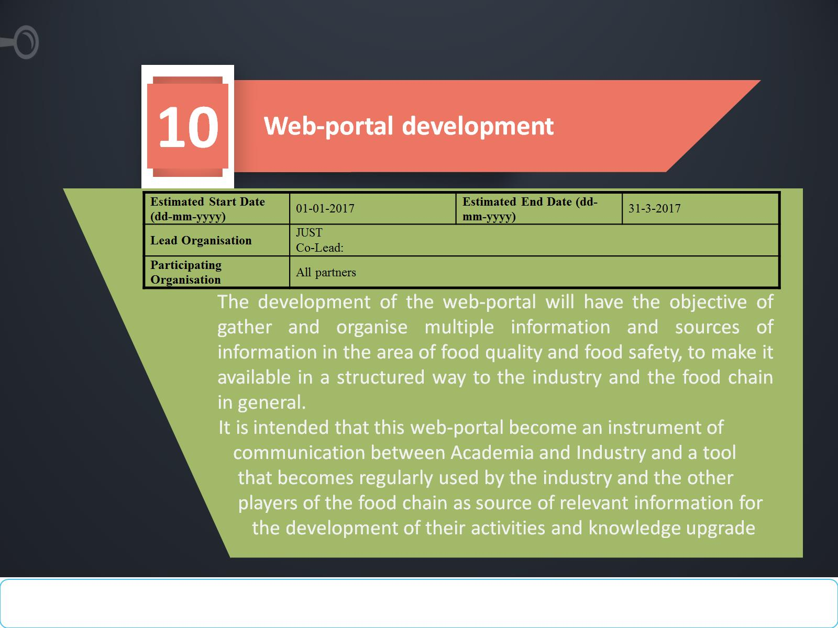

Slide 38
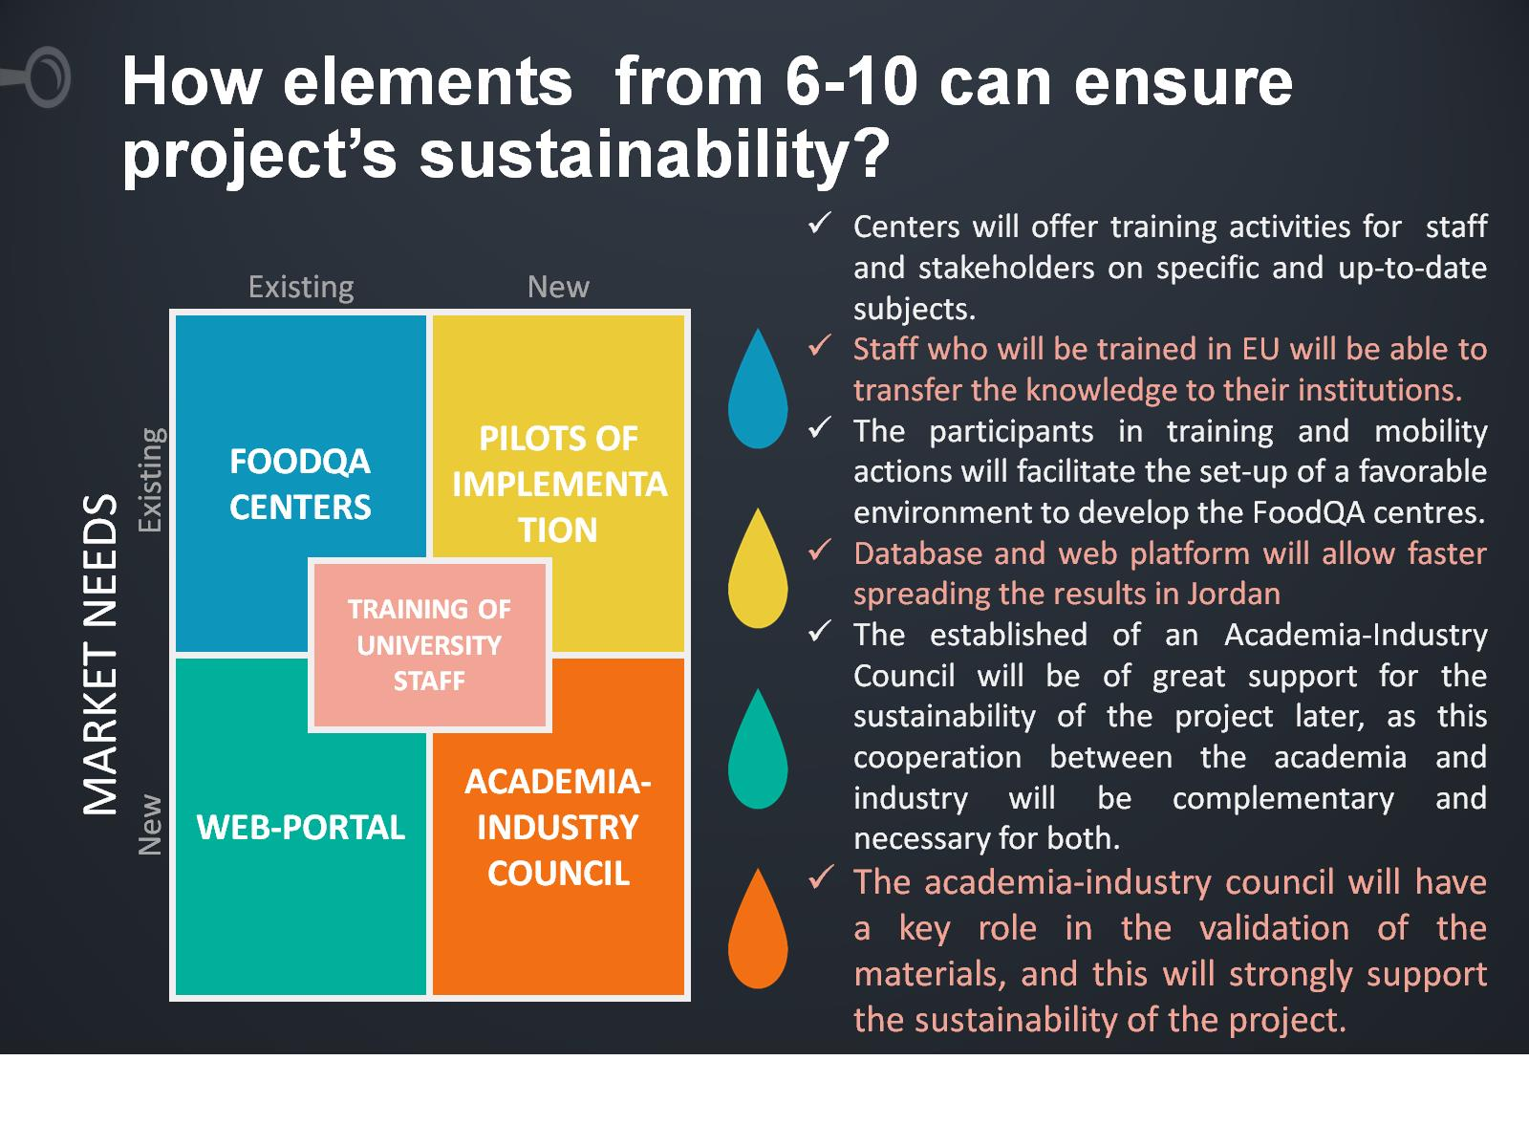
How elements from 6-10 can ensure project’s sustainability?

Slide 39
Development of sustainable plane implement by:
1) Description for post project action continuity,
2) Clear listing of activities to be done and the cost/sponsor of these after the end of the project,
3) Reviewing of the implantation of a frame work that ensure and realize the perfectness of the following pillars in activities of all partners: independence, self-reliance, self-sustaining, lasting, institutionalization, mainstreaming, continuation, durability, maintenance, reutilization, stabilization.
4) Designing a frame work that ensure and realize the perfectness of the following pillars in the activities of all partners: adoption, appropriation, consolidation, integration, longevity, permanence, perpetuation, persistence, survival, viability, devolution, graduation.
5) Reach consensus on a project’s exit strategies from the beginning based on greed upon sustainability criteria;
6) Develop a results-oriented sustainability strategy;

Slide 40
Just Sustainability Plan

Slide 41
1- Selected staff and students will receive comprehensive and specialized training on food quality and safety topics under the supervision of our European parties. They will be responsible for transferring the acquired skills and knowledge to students, staff and faculty members at JUST and to local community representing food industry professionals from various food companies.
A)The main activities of Food Safety and Quality Center.

Slide 42
2- The center will establish and sustain collaboration with food industry and Jordan Food and Drug Administration (FDA) through :
supporting faculty research and consultation with food industry
supporting faculty staff in both faculty of Agriculture and Faculty of Engineering to conduct audits for food quality and safety certifications such as ISO, HACCP, etc.

Slide 43
3-The center will establish collaboration with food industry and FDA by faculty supervision of graduate students to solve specific local food industry problems. Such cooperation will involve students visits to local companies and involvement in problem identification and solution.

Slide 44
And also the activity of Food center we help:
4-The food industry to get access to services and consultations by highly qualified faculty members in faculties of Agriculture, Engineering and Veterinary medicine to improve food manufacturing, equipment and plants design and development and operational practices to meet high quality standards.
5- food industry to get access to professional training materials including: videos, posters and brochures concerning good manufacturing practices (GMP's) related to various food industries.

Slide 45
B. Institutional support and infrastructure
1- The Food Safety and Quality center will be administered by the department of Nutrition and Food Technology, Faculty of Agriculture.
2- The center will have access to several laboratories and research centers at JUST, including but not limited to:
Dept. of Nutrition and Food Technology labs
Pilot plant at the Faculty of Agriculture
Unit operations pilot plant at Chemical Engineering dept.
University central analysis labs
Pharmaceutical Research Center
Nanotechnology institute

Slide 46
C. Financial resources and financial sustainability
Financial resources for specialized consultations and other R&D activities will be secured from various sources inside and outside the university.
Those may include but not limited to: deanship of scientific research, higher council of science and technology, scientific research fund at the Mistry of higher education and scientific research as well as many other funding agency.

Slide 47
Jerash University- Sustainability plan

Slide 49
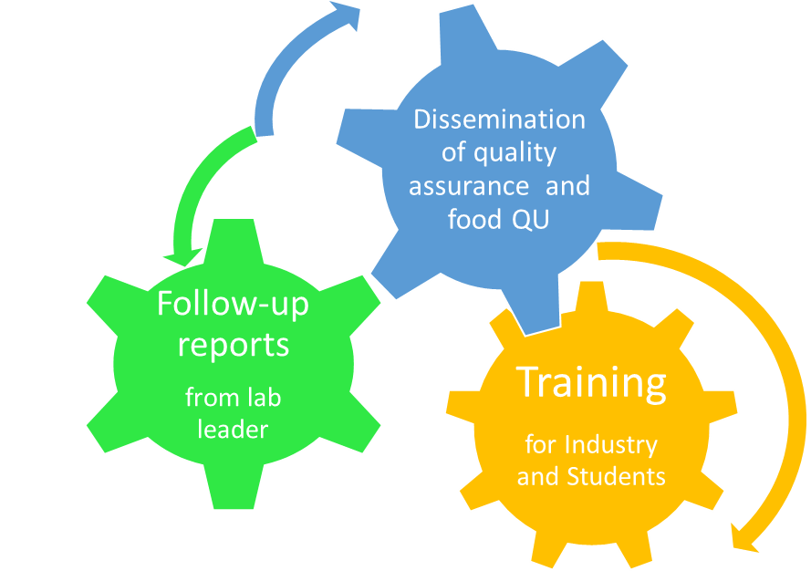
JU Sustainability Plan recognizes that creating a sustainable campus strengthens our core research and teaching mission, and it acknowledges that the challenges before us are complex and interconnected, demanding an ever-developing approach to sustainability.
•How we can do that?

Slide 50
Development and Training | Quality plane | Dissemination
Training of pre-trained staff members. Training of students using the lab. Choose one of the staff to follow the idea that was included in the training. | communicate with the partners in terms of deliverable quality. design quality standards in compliance with the European guidelines for higher education. Using laboratory by student and academia – industry for giving a lecture. | organize the web portal and the definition of the model of associated of the FoodQA centres and follow up it. Invitations to the representatives for the academia-industry council. Using the references which translated as reference for student research.

Slide 51
Sustainability plan from other Universities

Slide 52


